Slide 1


Basic Concepts of DBMS
Disclaimer: The content is curated for educational purposes only.
© Edunet Foundation. All rights reserved.

Slide 2
In this section, we will discuss:
Purpose of database systems
Data abstraction
Database Users
Data Independence (Logical & Physical)
Instance & Schemes
Three layered Architecture of DBMS
Different Levels of Abstraction.
Data Modeling
E-R Modeling
Logical Model: Object & Record based – Object oriented model - Entity relationship models
Entity sets & relationships sets

Slide 3
In this section, we will discuss:
Concept of attributes and relationships
Introduction to mapping constraints.
Basic Concepts of ER Model in DBMS
Introduction to DBMS
Structure of DBMS
Relational Models
Introduction to Hierarchical Model and Network Model
Introduction to RDBMS and Relational Models
Introduction to relational algebra and relational calculus
Understanding database technologies

Slide 4

In this section, we will discuss:
Relational Data Structure
Keys and Relational Data Manipulation
Relational Algebra
Relational Algebraic Operations
Set Operations
Fundamental Operations
Relational Calculus
Data Definition Language
Operators: select, project, join, rename etc.

Slide 5

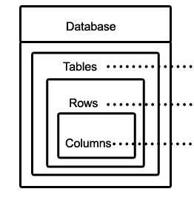
Purpose of database systems
What is Database?,
What is DBMS and types of DBMS ?
DBMS vs Flat File System
Image Source: https://www.google.com/url?sa=i&source=imgres&cd=&cad=rja&uact=8&ved=2ahUKEwjKg9PLw9PoAhXD

Slide 6
Purpose of database systems
What is Database?
A database is a data structure that stores organized information.
Databases contain multiple tables, which may each include several different
fields.
For example, a company database may include tables for products, employees, and financial records. Each of these tables would have different fields that are relevant to the information stored in the table.
Image Source: https://www.google.com/url?sa=i&source=imgres&cd=&cad=rja&uact=8&ved=2ahUKEwjKg9PLw9PoAhXD

Slide 7
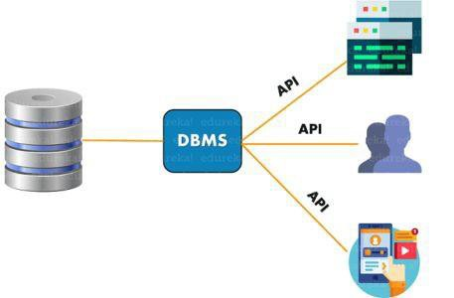
Purpose of database systems
What is DBMS?
DBMS or Database Management System is a software application used to access, create, and manage databases.
With the help of DBMS, you can easily create, retrieve and update data in databases.
A DBMS consists of a group of commands to manipulate the database and acts as an interface between the end-users and the database.
Image Source::
https://d1jnx9ba8s6j9r.cloudfront.net/blog/wp-content/uploads/2019/10/DATABASES-457x300.png

Slide 8
Purpose of database systems
Types of DBMS
File Processing System
Relational Database Management System (RDBMS)
Network Database Management System
(NDBMS)
Hierarchical Database Management System(HDBMS)
Object-Oriented Database Management System(OODBMS)
Image Source::
https://d1jnx9ba8s6j9r.cloudfront.net/blog/wp-content/uploads/2019/10/DATABASES-457x300.png

Slide 9
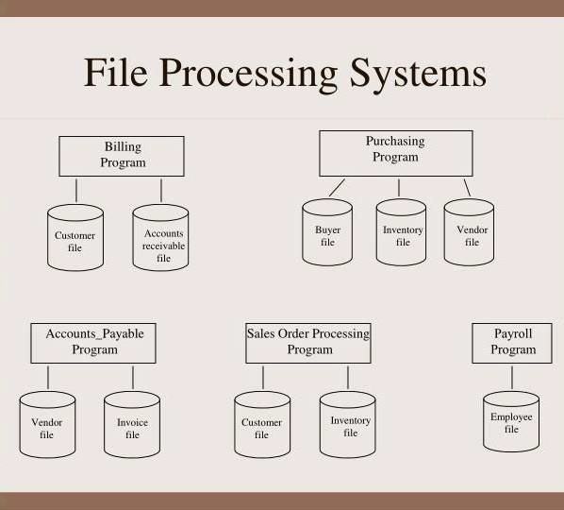
Types of DBMS
File Processing System
File Processing System is a traditional approach of storing and managing data.
Data Storage was being done by storing the information in files present in the computer.
.
Ima Source:: https://image.slideserve.com/1272110/file- processing-systems-n.jpg

Slide 10
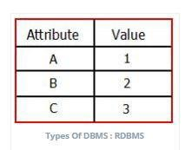
Types of DBMS
Relational Database Management System (RDBMS)
In Relational Database Management Systems, unlike file processing system the data is stored in the tables(having rows and columns)
Any table can be related or linked to any other table using certain concepts.
.
Image Source:: http://minigranth.com/wp-content/uploads/2018/04/Types-of-DBMSRDBMS.jpeg

Slide 11
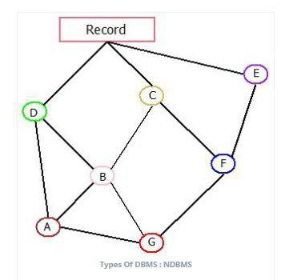
Types of DBMS
Network Database Management System(NDBMS)
Network Database Management System is another type which was very popular in the late 1970’s.
These databases were known to be very adaptable and flexible in terms of data storage because of their data storage architecture.
Image Source::
https://www.minigranth.com/wp-content/u ploads/2018/04/NDBMS.jpeg
.

Slide 12
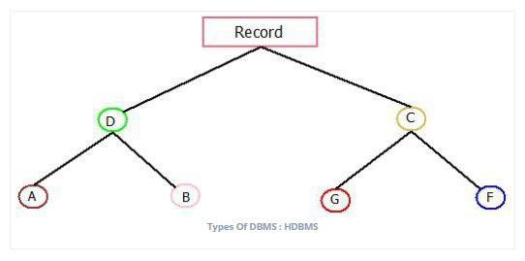
Types of DBMS
Hierarchical Database Management System(HDBMS)
The Hierarchical Database Management System works on the concept similar to that of “Concept Hierarchy” .
The whole database is structured and architecture in the form similar to the structure of tree, making it one of the simplest and fastest database present out there.
.
.
Image Source::
https://www.minigranth.com/wp-content/uploads/2018/04/HDBMS.jpeg
.

Slide 13
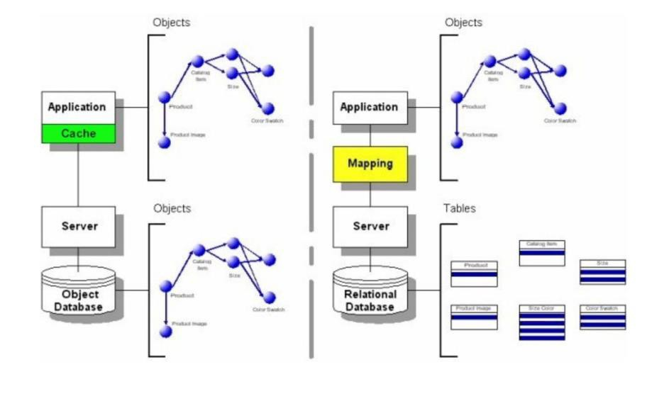
Types of DBMS
Object-Oriented Database Management Systems (OODBMS)
.
They are different from other databases as Object-Oriented Database Management Systems revolves around “Object”(An object here referred to any real world entity)
It is based upon the concept of various object oriented languages such as “C++, Java” etc.
.
Image Source:: https://miro.medium.com/max/2988/1*C3XqvO_wmVzxBcZngRCjPg.png
.

Slide 14
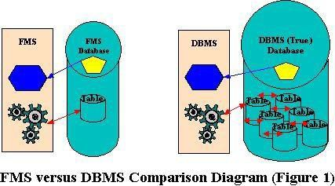
Purpose of database systems
File Management System | Database Management System
File System is a general, easy-to-use system to store general files which require less security and constraints. | Database management system is used when security constraints are high.
Data Redundancy is more in file management system. | Data Redundancy is less in database management system.
Data Inconsistency is more in file system. | Data Inconsistency is less in database management system.
Centralisation is hard to get when it comes to File Management System. | Centralisation is achieved in Database Management System.
DBMS vs Flat File System
.
.
Image Source::
https://www.sqlservercentral.com/wp-content/uploads/legacy/80e826a794a00213816 dc63e042e0a6c527670d0/DBMS_vs_FMS.jpg

Slide 15
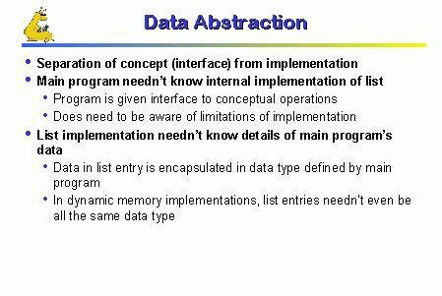
Data abstraction
What is Data Abstraction
●
●
Data system are made up of complex data structure
The use of data abstraction relates to the user
interaction with database
●
●
The developer hide internal detail from the users.
The process of hiding irrelevant detail from user is
called data abstraction.
.
.
Image Source::
https://blog.oureducation.in/data-abstraction-and-encapsulation/#!prettyPhoto/0/

Slide 16
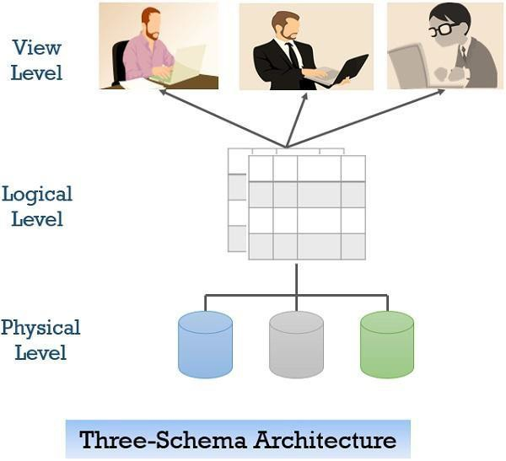
Data abstraction
Example of Data Abstraction
Let’s say we are storing customer information in a customer table.
At physical level these records can be described as blocks of storage (bytes, gigabytes, terabytes
. etc.) in memory.
These details are often hidden from the programmers.
.
Image Source::
https://binaryterms.com/wp-content/uploads/2019/11/View-of-data-three-schema-arch itecture.jpg

Slide 17
Data abstraction
Example of Data Abstraction
At the logical level these records can be described as fields and attributes along with their data types, their relationship among each other can be logically implemented.
The programmers generally work at this level
because they are aware of such things about database systems.
.
.
Image Source::
https://binaryterms.com/wp-content/uploads/2019/11/View-of-data-three-schema-arch itecture.jpg

Slide 18
Data abstraction
Example of Data Abstraction
At view level, user just interact with system with the help of GUI and enter the details at the screen.
They are not aware of how the data is stored and what data is stored; such details are hidden from
. them.
.
Image Source::
https://binaryterms.com/wp-content/uploads/2019/11/View-of-data-three-schema-arch itecture.jpg

Slide 19
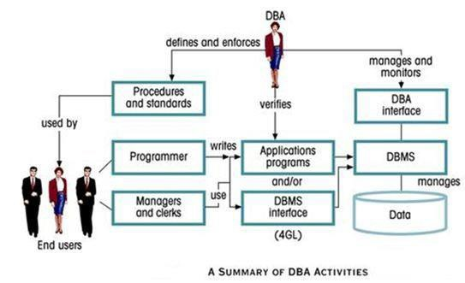
Database Users
What is DBA?
A database administrator (DBA) is the information technician responsible for directing or performing all activities related to maintaining a
successful database environment.
A DBA makes sure an organization's database and its related applications operate functionally and efficiently.
Image Source:: https://www.myreadingroom.co.in/images/stories/docs/dbms/summary%20of%20dba
%20activities.JPG

Slide 20
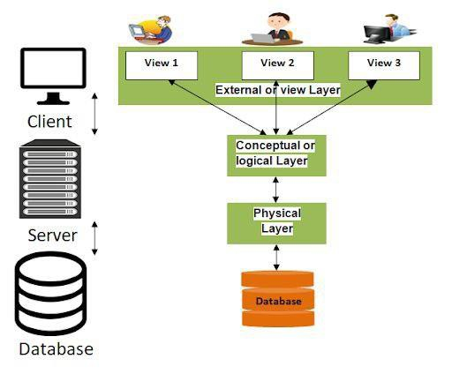
Data Independence
What is Conceptual/Logical Schema?
A conceptual schema is a high-level description of informational needs underlying the design of a database.
It typically includes only the main concepts and the main relationships among them.
Typically this is a first-cut model, with insufficient detail to build an actual database.
This level describes the structure of the whole database for a group of users.
The conceptual model is also known as
the data model that can be used to describe the conceptual schema when a database system is implemented It hides the internal details of physical storage and targets on
Image Source::
https://lh5.googleusercontent.com/proxy/z36HD9v_To7vjP1x-I-T9x_tjYK9xhqE-tlNenp55ykn5 4dGzLSCdsCPAvkis_h8njDRFqcnFw3GZpS9QbQU91qRCbA--A87zcVaK-8tZljQrlfTeIY1rcfse 9qEvlMu
describing entities, datatype, relationsh©ip^{Ed}s^{un}a^{et}n^{F}doundation. All rights reserved.

Slide 21
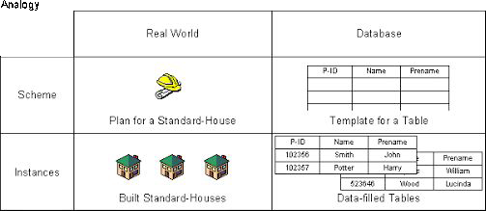
Instance & Schemes
n
BASIS FOR COMPARISON
I stance vs Schema
SCHEMA
INSTANCE
Basic
Description of the database.
Snapshot of a database at a specific moment.
Change occurrence
Rare
Frequent
Initial state
Empty
Always have some data.
Image Source:: https://lh6.googleusercontent.com/proxy/NmDlYKVTeT5KJ4cViogUgX8dpSmxe0VqqjlLC0RX vd5oBtKoLd9gGvmWHU_088z8K2aKLQl-o6Qn74wprAmY14U6cHpYmaf5-hDK

Slide 22
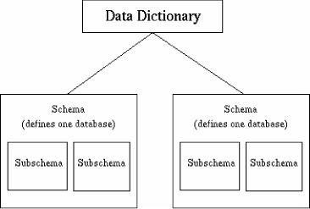
Instance & Schemes
What is Sub-schema?
Subschema is a sub part of a schema and inherits same properties of schema.
Subschema describes different view of the database.
Subschema is an application programmer’s or user view of data item types and records type.
For example: Suppose a table employee, programmer has access of all columns of table employee but user has access of only two or three columns of table employee. Subschema describes different view of the database.
Image Source:: https://lh6.googleusercontent.com/proxy/NmDlYKVTeT5KJ4cViogUgX8dpSmxe0VqqjlLC0RX vd5oBtKoLd9gGvmWHU_088z8K2aKLQl-o6Qn74wprAmY14U6cHpYmaf5-hDK

Slide 23
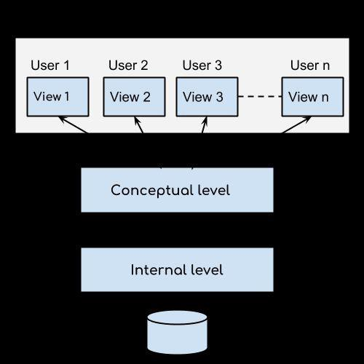
Three layered Architecture of DBMS
External, Conceptual & Internal Level
This architecture has three levels:
External level
Conceptual level
Internal level
Image
Source::https://beginnersbook.com/wp-content/uploads/2018/11/dbms_three_level_architecture.png

Slide 24
Three layered Architecture of DBMS
External Level
It is also called view level.
The reason this level is called “view” is because several users can view their desired data from this level which is internally fetched
from database
The data is fetched with the help of conceptual and internal level mapping.
Image
Source::https://beginnersbook.com/wp-content/uploads/2018/11/dbms_three_level_architecture.png

Slide 25
Three layered Architecture of DBMS
Conceptual Level
It is also called logical level.
The whole design of the database such as relationship among data, schema of data etc.
are described in this level.
Image
Source::https://beginnersbook.com/wp-content/uploads/2018/11/dbms_three_level_architecture.png

Slide 26
Three layered Architecture of DBMS
Internal Level
This level is also known as physical level.
This level describes how the data is actually stored in the storage devices.
This level is also responsible for allocating
space to the data. This is the lowest level of the architecture.
Image
Source::https://beginnersbook.com/wp-content/uploads/2018/11/dbms_three_level_architecture.png

Slide 27
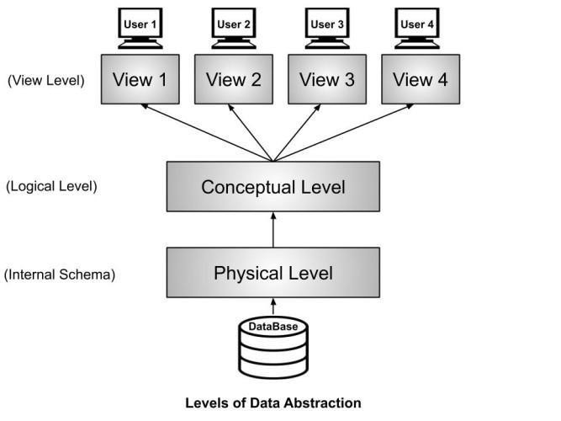
Different level of abstraction
Physical, Logical & View level
The three-schema architecture defines the view of data at three levels:
Physical level (internal level)
Logical level (conceptual level)
. View level (external level)
.
Image Source::
https://binaryterms.com/wp-content/uploads/2019/11/View-of-data-three-schema-arch itecture.jpg

Slide 28
Different level of abstraction
Physical level
The physical or the internal level schema describes how the data is stored in the hardware.
It also describes accessed.
.
how the data can be
.
Image Source::
https://binaryterms.com/wp-content/uploads/2019/11/View-of-data-three-schema-arch itecture.jpg

Slide 29
Different level of abstraction
Logical level
It is a level above the physical level. Here, the data is stored in the form of the entity
set, entities, their data types.
The relationship among the entity sets, user
. operations performed to retrieve or modify the data and certain constraints on the data.
.
Image Source::
https://binaryterms.com/wp-content/uploads/2019/11/View-of-data-three-schema-arch itecture.jpg

Slide 30
Different level of abstraction
View level
.
It is the highest level of data abstraction and exhibits only a part of the whole database.
It exhibits the data in which the user is
. interested.
.
Image Source::
https://binaryterms.com/wp-content/uploads/2019/11/View-of-data-three-schema-arch itecture.jpg

Slide 31
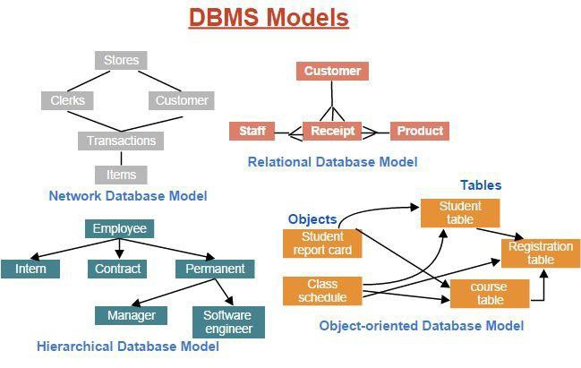
Data Modeling
What is Data Modeling?
Data models define how the logical structure of a database is modeled.
. Data Models are fundamental entities to introduce abstraction in a DBMS.
.
Image Source::
https://www.assignmenthelp.net/assignment_help/images/database-models.png

Slide 32
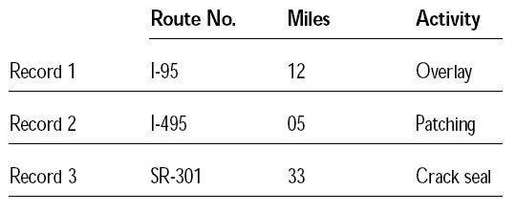
Data Modeling
Flat Data Model
Flat data model is the first introduced traditional data model where data is kept in the same plane.
This is a very old model which is not much scientific.
Image Source::
https://www.assignmenthelp.net/assignment_help/images/database-models.png

Slide 33
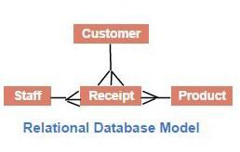
Relational Data Model
The most popular and extensively used data model isDthae rtealatioMnalodadtaemloidnel.g
The data model allows the data to be stored in
tables called relation.
The relations are normalized and the normalized relation values are known as atomic values. E ach of the rows in a relation is called tuples which contains the unique value.
The attributes are the values in each of the columns which are of the same domain.
.
.
Image Source::
https://www.assignmenthelp.net/assignment_help/images/database-models.png

Slide 34
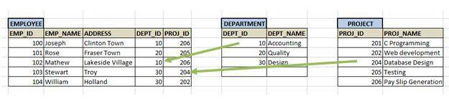
Data Modeling
Record base Data Model
The record-based data model is used to determine the overall design of the database.
This data model contains different kinds of record types.
Each of the record types has a fixed length and a fixed number of fields.
Image Source::
https://www.tutorialcup.com/images/dbms/record-based-data-models/Relational-Data
-Models2.png

Slide 35
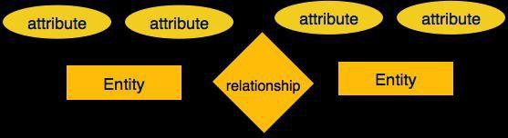
E-R Modeling
Entity-Relationship (ER) Model is based on the notion o_{C}f r_{o}ea_{m}l-w_{p}o_{o}rld_{n}e_{e}n_{n}tit_{t}ie_{s}s _{o}an_{f}d_{E}re_{R}la₋ti_{D}on_{i}s_{a}h_{g}ip_{r}s_{a}a_{m}mo_{s}ng them.
While formulating real-world scenario into the database
model, the ER Model creates entity set, relationship set, general attributes and constraints.
ER Model is best used for the conceptual design of a database.
ER Model is based on −
Entities and their attributes.
Relationships among entities.
.
.
Image Source:: https://www.assignmenthelp.net/assignment_help/images/database-models.png

Slide 36
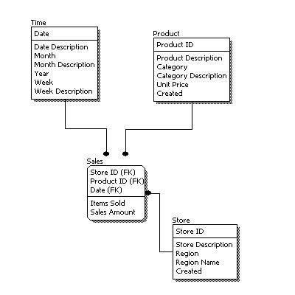
Logical Model: Object & Record based – Object oriented model
Steps of ER Model
A logical data model describes the data in as much
detail as possible, without regard to how they will be physical implemented in the database.
Features of a logical data model include:
Includes all entities and relationships among them.
All attributes for each entity are specified.
The primary key for each entity is specified.
Foreign keys (keys identifying the relationship between different entities) are specified.
Normalization occurs at this level.
.
.
Image Source:: https://www.1keydata.com/datawarehousing/logical-data-model.jpg

Slide 37
Logical Model: Object & Record based – Object oriented model
Steps of ER Model
The steps for designing the logical data model are as follows:
Specify primary keys for all entities.
Find the relationships between different entities.
Find all attributes for each entity.
. ○ Resolve many-to-many relationships.
Normalization.
.
Image Source:: https://www.1keydata.com/datawarehousing/logical-data-model.jpg

Slide 38
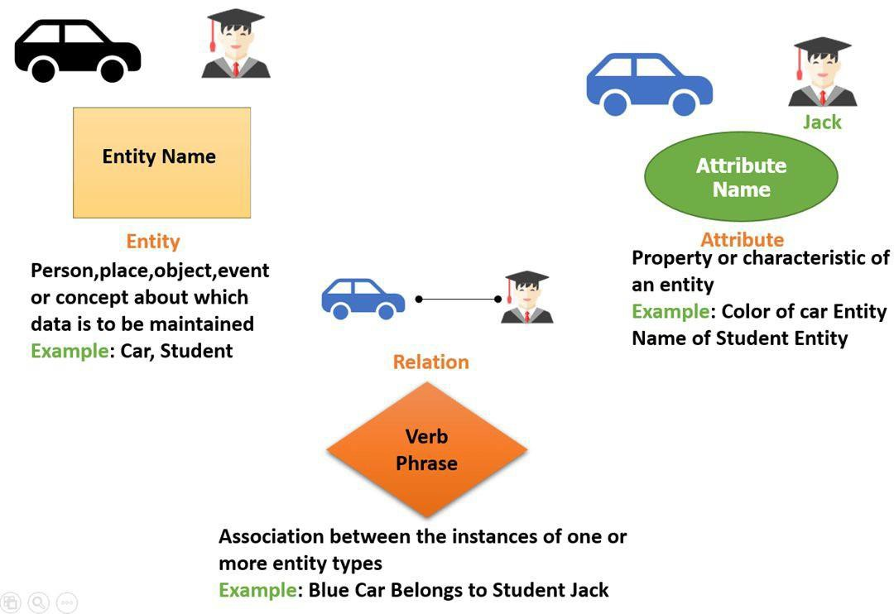
Entity sets & relationships sets
Entity
An entity refers to any object having-
Either a physical existence such as a particular person, office, house or car.
Or a conceptual existence such as a school, a university, a company or a job.
.
.
Image Source:: https://www.guru99.com/images/1/100518_0621_ERDiagramTu2.png

Slide 39
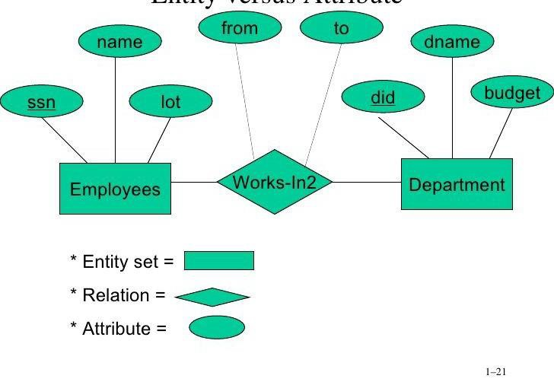
Entity sets & relationships sets
Entity Sets
Entity Set is a collection or a group of ‘entities’ sharing exactly the ‘same set of attributes’.
All entities can be distinctly identified in an entity set.
This is because all the entities have a different set of value for some set of attributes.
We further classify the entity set into two basic categories Strong and Weak entity set.
.
.
Image Source::
https://image.slidesharecdn.com/27fcs157al4-111005002541-phpapp01/95/dbms-unit 1-21-728.jpg?cb=1317774454

Slide 40
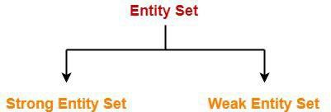
Entity sets & relationships sets
Types of Entity Sets
An entity set may be of the following two types-
Strong entity set
Weak entity set
.
.
Image Source::
https://www.gatevidyalay.com/wp-content/uploads/2018/05/Strong-Entity-Set-Exampl e.png

Slide 41
Types of Entity Sets
Strong Entity Set
A strong entity set is an entity set that contains sufficient attributes to uniquely identify all its entities.
In other words, a primary key exists for a strong entity set.
Primary key of a strong entity set is represented by underlining it.
.
.
Image Source::
https://www.gatevidyalay.com/wp-content/uploads/2018/05/Strong-Entity-Set-Exampl e.png

Slide 42
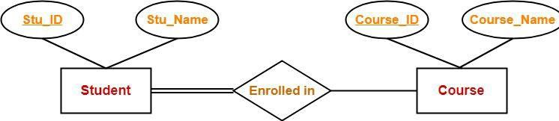
Types of Entity Sets
Strong Entity Set
Symbols Used-
A single rectangle is used for representing a strong entity set.
A diamond symbol is used for representing the relationship that exists between two strong entity sets.
A single line is used for representing the connection of
.
the strong entity set with the relationship set.
A double line is used for representing the total participation of an entity set with the relationship set.
Total participation may or may not exist in the relationship.
.
Image Source::
https://www.gatevidyalay.com/wp-content/uploads/2018/05/Strong-Entity-Set-Exampl e.png

Slide 43
Types of Entity Sets
Weak Entity Set
A weak entity set is an entity set that does not contain sufficient attributes to uniquely identify its entities.
In other words, a primary key does not exist for a weak entity set.
However, it contains a partial key called as a
discriminator.
Discriminator can identify a group of entities from the
.
entity set.
Discriminator is represented by underlining with a dashed line.
.
Image Source::
https://www.gatevidyalay.com/wp-content/uploads/2018/05/Strong-Entity-Set-Exampl e.png

Slide 44
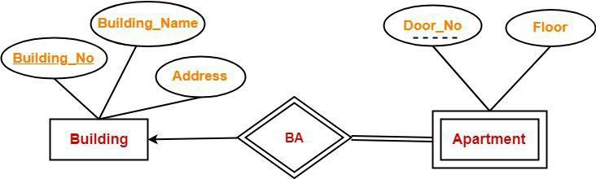
Types of Entity Sets
Symbols Used-
Weak Entity Set
A double rectangle is used for representing a weak entity set.
A double diamond symbol is used for representing the relationship that exists between the strong and weak entity sets and this relationship is known as identifying relationship.
A double line is used for representing the connection of the weak entity set with the relationship set.
.
Total participation always exists in the identifying relationship.
.
Image Source::
https://www.gatevidyalay.com/wp-content/uploads/2018/05/Strong-Entity-Set-Exampl e.png

Slide 45
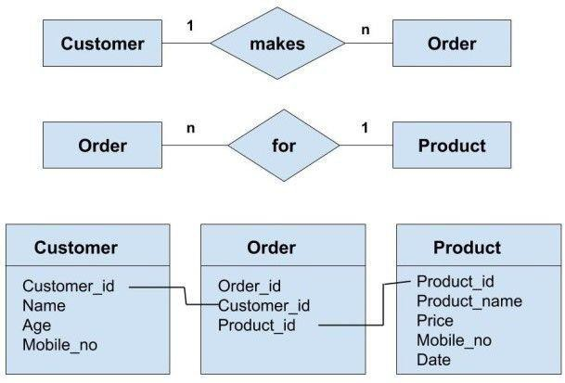
Entity sets & relationships sets
Relationship
Entities may have several relationships among_{s} themselves.
Whenever an attribute of one entity refers to another entity, there exists a relationship between the two entities.
A relationship, in the context of databases, is a
situation that exists between two relational database tables when one table has a foreign
. key that references the primary key of the other table.
Relationships allow relational databases to split
. and store data in different tables, while linking disparate data items.
Image Source::
https://s3.ap-south-1.amazonaws.com/afteracademy-server-uploads/what-are-the-diff erent-types-of-relationships-in-dbms-many-to-many-relationship-examples-c961b29d 4c8aa6a5.jpg

Slide 46
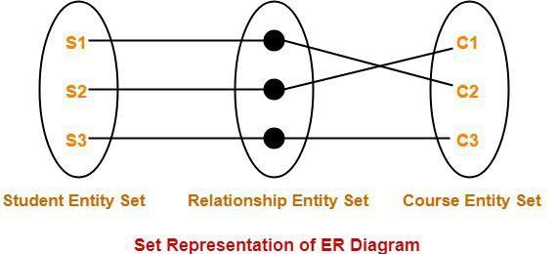
Entity sets & relationships sets
Relationships sets
A relationship set is a set of relationships of same type.
Example - Set representation of above ER diagram is - Degree of a Relationship Set-.
The number of different entity sets participating in a relationship set is called as degree of a relationship set.
.
.
Image Source::
https://www.gatevidyalay.com/wp-content/uploads/2018/05/Set-Representation-of-ER
-Diagram.png

Slide 47
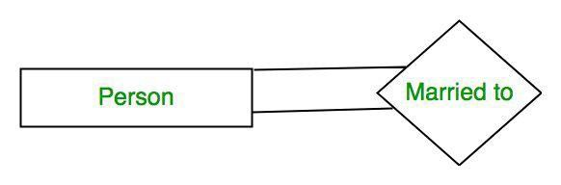
Entity sets & relationships sets
Types of Relationships sets
Unary Relationship
Binary Relationship
n-ary Relationship
.
.
Image Source::
https://media.geeksforgeeks.org/wp-content/uploads/Database-Management-System
-ER-Model-10.png

Slide 48
Types of Relationships sets
Unary Relationship
When there is only ONE entity set participating in a
relation, the relationship is called as unary relationship.
For example, one person is married to only one person.
.
.
Image Source::
https://media.geeksforgeeks.org/wp-content/uploads/Database-Management-System
-ER-Model-10.png

Slide 49
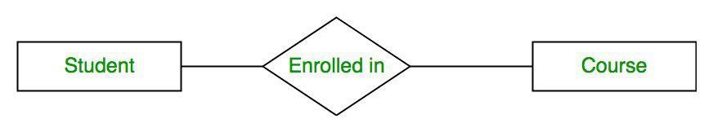
Types of Relationships sets
Binary Relationship
When there are TWO entities set participating in a relation, the relationship is called as binary relationship.
For example, Student is enrolled in Course.
.
.
Image Source::
https://media.geeksforgeeks.org/wp-content/uploads/Database-Management-System
-ER-Model-10.png

Slide 50
Types of Relationships sets
n-ary Relationship
When there are n entities set participating in a relation, the relationship is called as n-ary relationship.
.
.

Slide 51
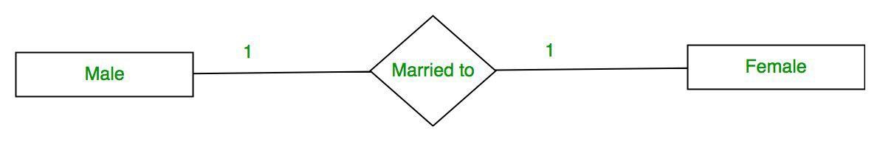
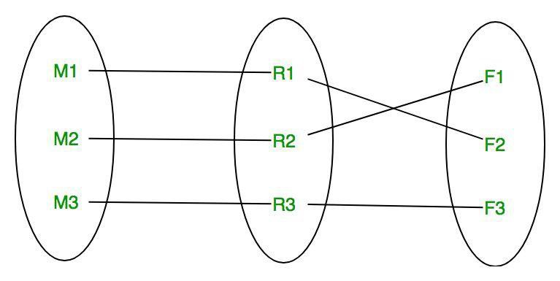
Entity sets & relationships sets
Cardinality of Relationships sets
The number of times an entity of an entity set
participates in a relationship set is known as cardinality.
Cardinality can be of different types:
.
One to One
Many to One
Many to Many
.
Image Source::
https://media.geeksforgeeks.org/wp-content/uploads/Database-Management-System
-ER-Model-13.png

Slide 52
Cardinality of Relationships sets
One to one
When each entity in each entity set can take part only once in the relationship, the cardinality is one to one.
Let us assume that a male can marry to one female and a female can marry to one male.
. So the relationship will be one to one.
.
Image Source::
https://media.geeksforgeeks.org/wp-content/uploads/Database-Management-System
-ER-Model-13.png

Slide 53
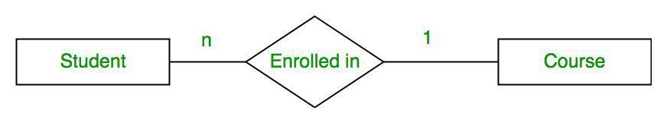
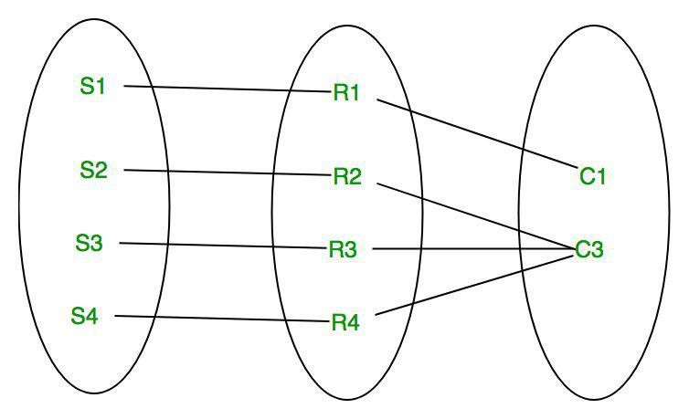
Cardinality of Relationships sets
When entities in one entity ^{M}setªc^{n}an^{y}ta^{t}kºe pºa^{n}rt^{e}only once in the relationship set and entities in other entity set
can take part more than once in the relationship set,
cardinality is many to one.
Let us assume that a student can take only one course but one course can be taken by many students.
. So the cardinality will be n to 1.
It means that for one course there can be n students
. but for one student, there will be only one course.
Image Source::
https://media.geeksforgeeks.org/wp-content/uploads/Database-Management-System
-ER-Model-13.png

Slide 54
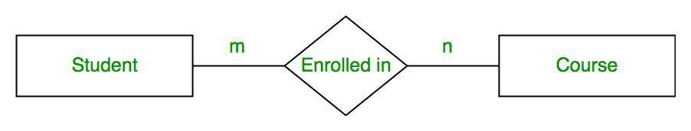
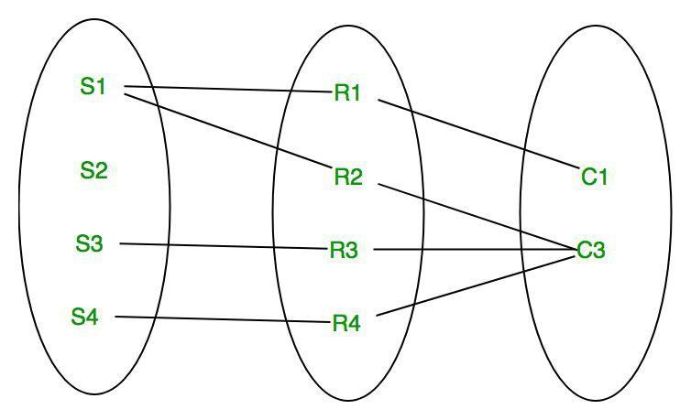
Cardinality of Relationships sets
Many to Many
When entities in all entity sets can take part more than once in the relationship cardinality is many to many.
Let us assume that a student can take more than one course and one course can be taken by many students.
So the relationship will be many to many.
.
.
Image Source::
https://media.geeksforgeeks.org/wp-content/uploads/Database-Management-System
-ER-Model-13.png

Slide 55
Attributes
Tuple
Field1 | Field2 | Field--- | Field_N
Concept of Attribute

Slide 56
Concept of Attribute
Attributes
Tuple
Field1 | Field2 | Field--- | Field_N
Concept
Attribute describes property of entity.
It is used in entity relationship diagram.
Graphical presentation.

Slide 57
Concept of Attribute
Simple Attribute
Symbols used to represent attributes
Multivalued Attribute
Key Attribute
Symbols
Composite Attribute

Slide 58
Concept of Attribute
Derived Attribute
Symbols used to represent attributes
Symbols

Slide 59
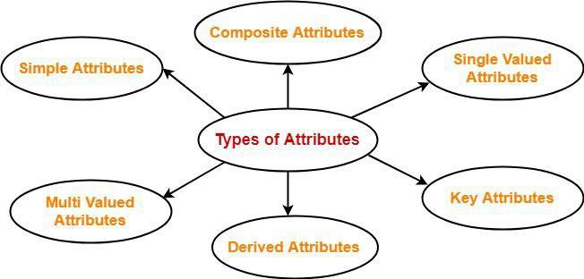
Concept of Attribute
Types of Attributes
Simple Attributes
Composite Attributes
Single Valued Attributes
Key Attributes
Derived Attributes
Multivalued Attributes
https://www.gatevidyalay.com/wp-content/uploads/2018/06/Attributes-in-DBMS-Types.png

Slide 60
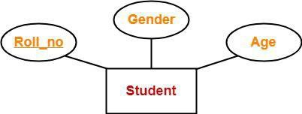
Concept of Attribute
Types of Attributes Simple Attributes
A simple attribute is identify entity from an entity set.
Simple attribute represent oval symbol with its value.
https://www.gatevidyalay.com/wp-content/uploads/2018/06/Key-Attributes-Example.png
© Edunet Foundation. All rights reserved.

Slide 61
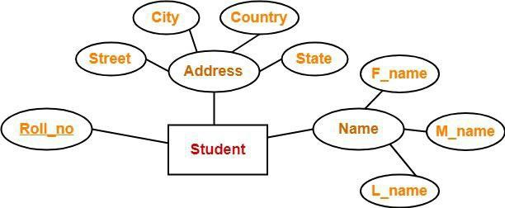
Concept of Attribute
Types of Attributes Composite Attributes
Composite attributes are those attributes which are composed of many other simple attributes.
COMPOSITE KEY is a combination of two or more columns that uniquely identify rows in a table.
https://www.gatevidyalay.com/wp-content/uploads/2018/06/Composite-Attributes-Example.png
© Edunet Foundation. All rights reserved.

Slide 62
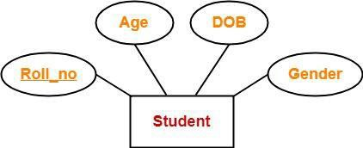
Concept of Attribute
Types of Attributes Single Valued Attributes
Single valued attributes are those attributes which can take only one value for a given entity from an entity set.
https://www.gatevidyalay.com/wp-content/uploads/2018/06/Single-Valued-Attributes-Example.png
© Edunet Foundation. All rights reserved.

Slide 63
Concept of Attribute
Types of Attributes Key Attributes
A key attribute is uniquely identify entity from an entity set.
Key attribute represent oval symbol same as like other with underline.
https://www.gatevidyalay.com/wp-content/uploads/2018/06/Key-Attributes-Example.png
© Edunet Foundation. All rights reserved.

Slide 64
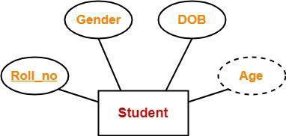
Concept of Attribute
Types of Attributes Derived Attributes
Derived attributes are those attributes which can be derived from other attribute(s).
https://www.gatevidyalay.com/wp-content/uploads/2018/06/Derived-Attributes-Example.png
© Edunet Foundation. All rights reserved.

Slide 65
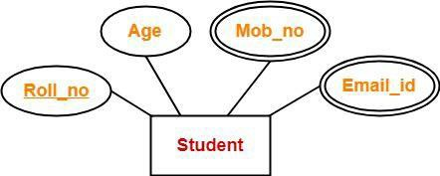
Concept of Attribute
Types of Attributes Multivalued Attributes
Multi valued attributes are those attributes which can take more than one value for a given entity from an entity set.
https://www.gatevidyalay.com/wp-content/uploads/2018/06/Multi-Valued-Attributes-Example.png
© Edunet Foundation. All rights reserved.

Slide 66
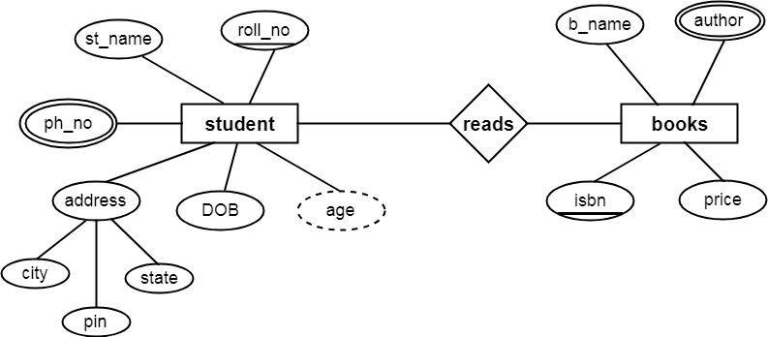
Example 1
https://www.csetutor.com/wp-content/uploads/2018/09/ER-Diagram-in-DBMS-Example.png
© Edunet Foundation. All rights reserved.

Slide 67
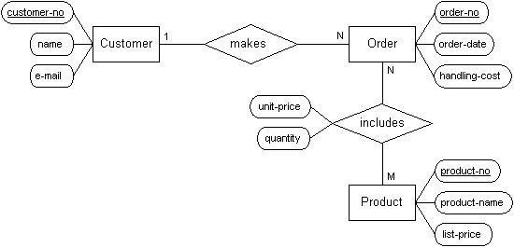
Example 2
https://codeandwork.github.io/courses/cs/media/erdiagram2.jpg
© Edunet Foundation. All rights reserved.

Slide 68
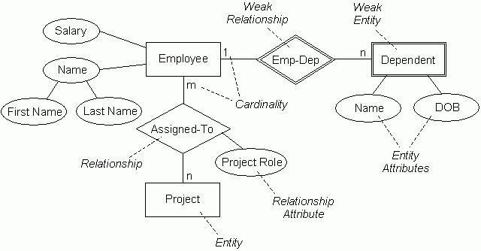
https://codeandwork.github.io/courses/cs/media/erd-employee.jpg

Slide 69
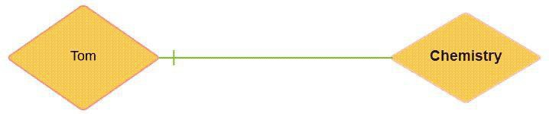
Concept of Relationship
Concept of Relationship
Relationship is nothing but an association among two or more entities.
Entities take part in relationships. We can often identify relationships with verbs or verb phrases.
https://www.guru99.com/images/1/100518_0621_ERDiagramTu4.png
© Edunet Foundation. All rights reserved.

Slide 70
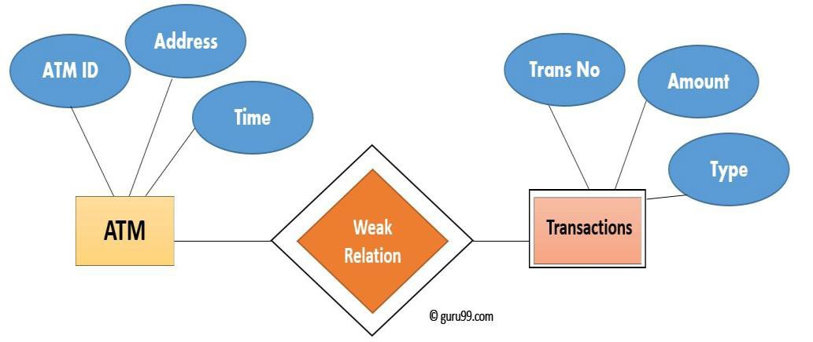
Concept of Relationship
Concept of Relationship
A weak entity is a type of entity which doesn't have its key attribute.
It can be identified uniquely by considering the primary key of another entity. For that, weak entity sets need to have participation
https://www.guru99.com/images/1/100518_0621_ERDiagramTu5.png

Slide 71
Types of Keys
Keys
Primary
Foreign
Super
Candidate
Unique
Keys
Keys play an important role in the relational database.
It is used to uniquely identify any record or row of data from the table.
It is also used to establish and identify relationships between tables.
Continued

Slide 72
Example
Types of Keys
Primary Key
StudID | First Name | Email
1 | Tom | abc@gmail.com
2 | Nick | xyz@gmail.com
3 | Dana | mno@yahoo.com
StudID
First Name
Email
PRIMARY KEY It is the first key which is used to identify one and only one instance of an entity uniquely.
Student
Continued

Slide 73
Example
Types of Keys
Rule for defining primary key
StudID | First Name | Email
1 | Tom | abc@gmail.com
2 | Nick | xyz@gmail.com
3 | Dana | mno@yahoo.com
Two rows can't have the same primary key value
It must for every row to have a primary key value.
The primary key field cannot be null.
The value in a primary key column can never be modified or updated if any
foreign key refers to that primary key.
StudID
First Name
Email
Student
Continued

Slide 74
Example
DeptCode | DeptName
001 | Science
002 | English
005 | Computer
Types of Keys
Foreign Key
Teacher ID | Fname | Lname
B002 | David | Warner
B017 | Sara | Joseph
B009 | Mike | Brunton
FOREIGN KEY is a column that creates a relationship between two tables.
The purpose of Foreign keys is to maintain data integrity and allow navigation between two different instances of an entity.
Continued

Slide 75
Example
Types of Keys
Rule for defining foreign key
Teacher ID | DeptCode | Fname | Lname
B002 | 002 | David | Warner
B017 | 002 | Sara | Joseph
B009 | 001 | Mike | Brunton
Foreign key columns must use their referenced column's type.
Each column cannot belong to more than 1 Foreign Key constraint.
Cannot be a computed column.
Foreign key columns must be indexed.
Continued

Slide 76
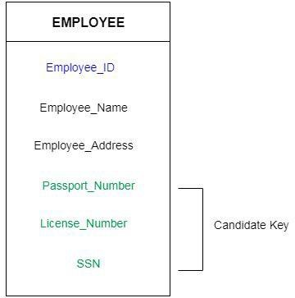
Types of Keys
Candidate Key
A candidate key is an attribute or set of an attribute which can uniquely identify a tuple.
The remaining attributes except for primary key are considered as a candidate key. The candidate keys are as strong as the primary key.
Continued
https://static.javatpoint.com/dbms/images/dbms-candidate-key.png
© Edunet Foundation. All rights reserved.

Slide 77
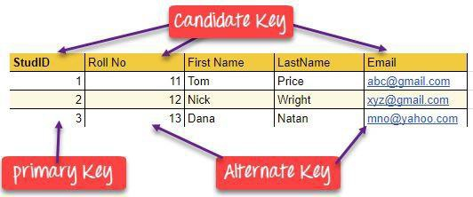
Types of Keys
Rule for defining candidate key
It must contain unique values
Candidate key may have multiple attributes
Must not contain null values
It should contain minimum fields to ensure uniqueness
Uniquely identify each record in a table
Continued
https://www.guru99.com/images/1/100518_0517_DBMSKeysPri1.png
© Edunet Foundation. All rights reserved.

Slide 78
Types of Keys
EmpSSN | Emp_No | Emp_Name
9812345098 | AB05 | Satish
9876512345 | AB06 | Anip
199937890 | AB07 | Khan
Super Key
A superkey is a group of single or multiple keys which identifies rows in a table.
A Super key may have additional attributes that are not needed for unique identification.
In the above-given example, EmpNo and Emp_Name are superkeys.
Continued

Slide 79
Types of Keys
OrderNo | PorductID | Product Name | Quantity
B005 | JAP102459 | Mouse | 5
B005 | DKT32157 3 | USB | 10
B005 | OMG44678 9 | LCD Monitor | 20
B004 | DKT32157 3 | USB | 15
B002 | OMG44678 9 | Laser Printer | 3
Compound Key
COMPOUND KEY has two or more attributes that allow you to uniquely recognize a specific record.
It is possible that each column may not be unique by itself within the database
Order ID and Product ID could be used as it uniquely identified each record.
Continued

Slide 80
Types of Keys
OrderNo | PorductID | Product Name | Quantity
B005 | JAP102459 | Mouse | 5
B005 | DKT32157 3 | USB | 10
B005 | OMG44678 9 | LCD Monitor | 20
B004 | DKT32157 3 | USB | 15
B002 | OMG44678 9 | Laser Printer | 3
Alternate Key
ALTERNATE KEYS is a column or group of columns in a table that uniquely identify every row in that table.
A table can have multiple choices for a primary key but only one can be set as the primary key.
All the keys which are not primary key are called an Alternate Key.
Continued

Slide 81
Types of Keys
OrderNo | PorductID | Product Name | Quantity
B005 | JAP102459 | Mouse | 5
B005 | DKT32157 3 | USB | 10
B005 | OMG44678 9 | LCD Monitor | 20
B004 | DKT32157 3 | USB | 15
B002 | OMG44678 9 | Laser Printer | 3
Unique Key
A unique key is a set of one or more than one fields/columns of a table that uniquely identify a record in a database table.

Slide 82

Introduction to Mapping
Constraints
https://static.javatpoint.com/dbms/images/dbms-mapping-constraints4.png

Slide 83
Introduction to Mapping
Constraints
Introduction
A mapping constraint is a data constraint that expresses the number of entities to which another entity can be related via a relationship set.
Mapping constraints defines how many entities can be related to another entity to a relationship
https://static.javatpoint.com/dbms/images/dbms-mapping-constraints4.png

Slide 84

Introduction to Mapping
Constraints
Types of Mapping Constraints
It is most useful in describing the relationship sets that involve more than two entity sets.
Binary Relationship
One to one (1:1)
One to many (1:M)
Many to one (M:1)
Many to many (M:M)
https://prepinsta.com/wp-content/uploads/2019/07/30-300x300.png

Slide 85

Introduction to Mapping
Constraints
One to One (1:1)
An entity in E1 is associated with at most one entity in E2, and an entity in E2 is associated with at most one entity in E1.
https://prepinsta.com/wp-content/uploads/2019/07/30-300x300.png

Slide 86

Introduction to Mapping
Constraints
One to One (1:1)
The above example describes that one student can enroll only for one course and a course will also have only one Student.
https://www.studytonight.com/dbms/images/one-to-one-example.jpg

Slide 87

Introduction to Mapping
Constraints
One to Many (1:M)
An entity in E1 is associated with many entities of E2, and an entity in E2 can be associated with atmost one entity in E1.
https://static.javatpoint.com/dbms/images/dbms-mapping-constraints2.png
© Edunet Foundation. All rights reserved.

Slide 88

Introduction to Mapping
Constraints
One to Many (1:M)
this relationship, which means that 1 student can opt for many courses, but a course can only have 1 student.
https://static.javatpoint.com/dbms/images/dbms-mapping-constraints2.png
© Edunet Foundation. All rights reserved.

Slide 89

Introduction to Mapping
Constraints
Many to One (M:1)
An entity in E1 is associated with at most one entity in E2, and an entity in E2 is associated with any number of entities in E1.
https://static.javatpoint.com/dbms/images/dbms-mapping-constraints3.png
© Edunet Foundation. All rights reserved.

Slide 90

Introduction to Mapping
Constraints
Many to One (M:1)
Student enrolls for only one Course but a Course can have many Students.
.
https://static.javatpoint.com/dbms/images/dbms-mapping-constraints3.png
© Edunet Foundation. All rights reserved.

Slide 91
Introduction to Mapping
Constraints
Many to Many (M:M)
An entity in E1 is associated with any number of entities in E2, and an entity in E2 is associated with any number of entities in E1.
.
https://static.javatpoint.com/dbms/images/dbms-mapping-constraints4.png

Slide 92

Introduction to Mapping
Constraints
Many to Many (M:M)
One student can enroll for more than one courses. And a course can have more than 1 student enrolled in it.
.
https://www.studytonight.com/dbms/images/many-to-many-example.jpg

Slide 93

http://pld.cs.luc.edu/database/images/fig7.2.png

Slide 94

Example 2
https://www.researchgate.net/profile/Peretz_Shoval/publication/321352935/figure/fig1/AS:57156994214297 6@1513284301301/The-entity-relationship-diagram-for-the-movie-recommendation-system-Subtypes-are-

Slide 95

Introduction to DBMS
Image
Sourcehttps://d5ngkkf53wl41.cloudfront.net/interview-questions/dbms/what-is-db

Slide 96
Introduction to DBMS
Overview of DBMS
A database management system (DBMS) is a software tool that makes it possible to organize data in a database.
A DBMS consists of the following three elements:
Physical Database
Database Engine
Database Schema
Image Sourcehttps://d5ngkkf53wl41.cloudfront.net/interview-questions/dbms/what-is-dbms.png

Slide 97

Introduction to DBMS
Advantages of DBMS
Improved data sharing.
Improved data security.
Better data integration
Minimized data inconsistency
Improved data access.
Improved decision making.
Increased end-user productivity.
Image Source:
https://cdn5.vectorstock.com/i/1000x1000/21/59/dbms-database-management-system-computer-data-vect

Slide 98

Introduction to DBMS
Disadvantages of DBMS
Increased costs.
Management complexity.
Maintaining currency.
Frequent upgrade/replacement cycles.
Image Source:
https://www.qsstudy.com/wp-content/uploads/2018/10/Database-Management-System-3.jpg

Slide 99

Introduction to DBMS
Applications of DBMS
Image Source: https://cdn.educba.com/academy/wp-content/uploads/2019/03/Applications-of-DBMS.png
© Edunet Foundation. All rights reserved.

Slide 100

Structure to DBMS
Applications of DBMS
Image Source:
http://1.bp.blogspot.com/-GmlmEbglhWk/Vc12mfuuTYI/AAAAAAAABak/jYO7eiIdprw/s1600/Structure_of_D

Slide 101

Introduction to RDBMS
What is RDBMS
A Relational database management system (RDBMS) is a database management system (DBMS) that is based on the relational model as introduced by E. F. Codd.
Image Source:
https://www.learncomputerscienceonline.com/wp-content/uploads/2019/08/What-Is-RDBMS.jpg

Slide 102

Introduction to RDBMS
Database Architecture
A Relational database management system (RDBMS) is a database management system (DBMS) that is based on the relational model as introduced by E. F. Codd.
Image Source: https://www.guru99.com/images/1/042919_0417_DataIndepen1.png

Slide 103

Introduction to RDBMS
Logical two-tier Client / Server
Architecture
The user interfaces and application programs are run on the client-side.
The server side is responsible to provide the functionalities like: query processing and transaction management.
Image Source: https://static.javatpoint.com/dbms/images/dbms-2-tier-architecture.png
© Edunet Foundation. All rights reserved.

Slide 104

Introduction to RDBMS
Logical two-tier Client / Server
Architecture
The 3-Tier architecture is used in case of large web application.
The application on the client-end interacts with an application server which further communicates with the database system.
Image Source: https://static.javatpoint.com/dbms/images/dbms-2-tier-architecture.png
© Edunet Foundation. All rights reserved.

Slide 105

Relational Model
Image Source: https://www.guru99.com/images/1/091318_0803_RelationalD1.png

Slide 106
Relational Model
Relational Model Concepts
Attribute
Table
Tuple
Relational Schema
Degree Cardinality
Column
Relational Instance
Relational Key
Attribute Domain
Image Source: https://www.guru99.com/images/1/091318_0803_RelationalD1.png
© Edunet Foundation. All rights reserved.

Slide 107
Relational Model
Relational Integrity Constraints
Relational Integrity constraints is referred to conditions which must be present for a valid relation.
Categories
Domain constraints
Key constraints
Referential integrity constraints
Image Source: https://www.guru99.com/images/1/091318_0803_RelationalD1.png
© Edunet Foundation. All rights reserved.

Slide 108
Relational Model
Example:
Create DOMAIN CustomerName CHECK (value not NULL)
The example shown demonstrates creating a domain constraint such that CustomerName is not NULL
Domain Constraints
Domain constraints can be violated if an attribute value is not appearing in the corresponding domain or it is not of the appropriate data type.
Domain constraints specify that within each tuple, and the value of each attribute must be unique.
Image Source: https://www.guru99.com/images/1/091318_0803_RelationalD1.png
© Edunet Foundation. All rights reserved.

Slide 109
Relational Model
CustomerID | CustomerName | Status
1 | Google | Active
2 | Amazon | Active
3 | Apple | Inactive
Key Constraints
An attribute that can uniquely identify a tuple in a relation is called the key of the table. The value of the attribute for different tuples in the relation has to be unique.
In the given table, CustomerID is a key attribute of Customer Table. It is most likely to have a single key for one customer, CustomerID =1 is only for the CustomerName =" Google".
Image Source: https://www.guru99.com/images/1/091318_0803_RelationalD1.png
© Edunet Foundation. All rights reserved.

Slide 110

Relational Model
Referential Integrity Constraints
Referential integrity constraints is base on the concept of Foreign Keys.
Image Source: https://www.guru99.com/images/1/091318_0803_RelationalD2.png
© Edunet Foundation. All rights reserved.

Slide 111
Relational Model
Advantages
Simplicity
Structural Independence
Easy to use
Query Capability
Data Independence
Scalable
Image Source: https://www.guru99.com/images/1/091318_0803_RelationalD2.png
© Edunet Foundation. All rights reserved.

Slide 112
Relational Model
Properties of Relations
Name of the relation is distinct from all other relations.
Each relation cell contains exactly one atomic (single) value
Each attribute contains a distinct name
Attribute domain has no significance
tuple has no duplicate value
Order of tuple can have a different sequence
Image Source: https://www.guru99.com/images/1/091318_0803_RelationalD2.png
© Edunet Foundation. All rights reserved.

Slide 113

Introduction to Hierarchical Model
Image Source
https://www.tutorialspoint.com/assets/questions/images/154411-1532346635.jpg

Slide 114
Introduction to Hierarchical Model
Overview of Hierarchical Model
A hierarchical model represents the data in a tree-like structure in which there is a single parent for each record.
The hierarchy starts from the Root data, and expands like a tree, adding child nodes to the parent nodes.
Image Source https://www.tutorialspoint.com/assets/questions/images/154411-1532346635.jpg

Slide 115

Introduction to Hierarchical Model
Overview of Hirarchical Model
Image Source https://www.tutorialspoint.com/assets/questions/images/149006-1532346966.jpg
© Edunet Foundation. All rights reserved.

Slide 116
Introduction to Hierarchical Model
Disadvantages
When a user needs to store a record in a child table that is currently unrelated to any record in a parent table, it gets difficulty in recording and user must record an additional entry in the parent table.
This type of database cannot support complex relationships, and there is also a problem of redundancy.
Image Source https://www.tutorialspoint.com/assets/questions/images/154411-1532346635.jpg

Slide 117

Introduction to Hierarchical Model
Overview of Hirarchical Model
Image Source https://www.studytonight.com/dbms/images/hierarchical-dbms-model.png
© Edunet Foundation. All rights reserved.

Slide 118
Examples
Employee Management
Project Management
Event Management
Image Source https://www.tutorialspoint.com/assets/questions/images/154411-1532346635.jpg
© Edunet Foundation. All rights reserved.

Slide 119

Introduction to Network Model
Image Source https://www.tutorialspoint.com/assets/questions/images/120543-1532343127.jpg
© Edunet Foundation. All rights reserved.

Slide 120
Introduction to Network Model
Overview of Network Model
The network model is the extension of the hierarchical structure because it allows many-to-many relationships to be managed in a tree-like structure that allows multiple parents.
Image Source https://www.tutorialspoint.com/assets/questions/images/120543-1532343127.jpg
© Edunet Foundation. All rights reserved.

Slide 121
Introduction to Network Model
Overview of Network Model
It can represent redundancy in data more efficiently than that in the hierarchical model.
There can be more than one path from a previous node to successor node/s.
Image Source https://www.tutorialspoint.com/assets/questions/images/120543-1532343127.

Slide 122
Introduction to Network Model
Overview of Network Model
The operations of the network model are maintained by indexing structure of linked list (circular) where a program maintains a current position and navigates from one record to another by following the relationships in which the record participates.
Records can also be located by supplying key values.
Image Source
https://www.tutorialspoint.com/assets/questions/images/120543-1532343127.jpg

Slide 123
Introduction to Network Model
Advantages
Fast data access.
It also allows users to create queries that are more complex than those they created using a hierarchical database. So, a variety of queries can be run over this model.
Image Source https://www.tutorialspoint.com/assets/questions/images/120543-1532343127.jpg

Slide 124
Introduction to Network Model
Disadvantages
A user must be very familiar with the structure of the database to work through the set structures.
Updating inside this database is a tedious task. One cannot change a set
structure without affecting the application programs that use this
structure to navigate through the data.
Image Source https://www.tutorialspoint.com/assets/questions/images/120543-1532343127.jpg

Slide 125

Example
Overview of Hirarchical Model
Image Source : https://www.dbmsinternals.com/wp-content/uploads/2016/11/download.png

Slide 126
Introduction to DBMS
Image
Sourcehttps://d5ngkkf53wl41.cloudfront.net/interview-questions/dbms/what-is-db

Slide 127
Introduction to DBMS
Overview of DBMS
A database management system (DBMS) is a software tool that makes it possible to organize data in a database.
A DBMS consists of the following three elements:
Physical Database
Database Engine
Database Schema
Image Sourcehttps://d5ngkkf53wl41.cloudfront.net/interview-questions/dbms/what-is-dbms.png

Slide 128

Introduction to DBMS
Advantages of DBMS
Improved data sharing.
Improved data security.
Better data integration
Minimized data inconsistency
Improved data access.
Improved decision making.
Increased end-user productivity.
Image Source:
https://cdn5.vectorstock.com/i/1000x1000/21/59/dbms-database-management-system-computer-data-vect

Slide 129
Introduction to DBMS
Disadvantages of DBMS
Increased costs.
Management complexity.
Maintaining currency.
Frequent upgrade/replacement cycles.
Image Source:
https://www.qsstudy.com/wp-content/uploads/2018/10/Database-Management-System-3.jpg

Slide 130
Introduction to DBMS
Applications of DBMS
Image Source: https://cdn.educba.com/academy/wp-content/uploads/2019/03/Applications-of-DBMS.png
© Edunet Foundation. All rights reserved.

Slide 131
Structure to DBMS
Applications of DBMS
Image Source:
http://1.bp.blogspot.com/-GmlmEbglhWk/Vc12mfuuTYI/AAAAAAAABak/jYO7eiIdprw/s1600/Structure_of_D

Slide 132
DBMS VS File System
DBMS
In DBMS, the user is not required to write the procedures.
DBMS gives an abstract view of data that hides the details.
DBMS provides a crash recovery mechanism, i.e., DBMS protects the user from the system failure.
DBMS provides a good protection mechanism.
DBMS contains a wide variety of sophisticated techniques to store and retrieve the data.
DBMS takes care of Concurrent access of data using some form of locking.
File System
In this system, the user has to write the procedures for managing the database.
File system provides the detail of the data representation and storage of data.
File system doesn't have a crash mechanism, i.e., if the system crashes while entering some data, then the content of the file will lost.
It is very difficult to protect a file under the file system.
File system can't efficiently store and retrieve the data.
In the File system, concurrent access has many problems like redirecting the file while other deleting some information or updating some information.
Applications of DBMS
Image Source:
. All rights reserved.
© Edunet Foundatio
n

Slide 133
DBMS VS RDBMS
No. DBMS
RDBMS
1) DBMS applications store data as file.
RDBMS applications store data in a tabular form.
2) In DBMS, data is generally stored in either a hierarchical form or a navigational form.
In RDBMS, the tables have an identifier called primary key and the data values are stored in the form of tables.
Applications of DBMS
3) Normalization is not present in DBMS.
Normalization is present in RDBMS.
4) DBMS does not apply any security with regards to data manipulation.
RDBMS defines the integrity constraint for the purpose of ACID (Atomocity, Consistency, Isolation and Durability) property.
5) DBMS uses file system to store data, so there will be no relation between the tables.
in RDBMS, data values are stored in the form of tables, so a relationship between these data values will be stored in the form of a table as well.
6) DBMS does not support distributed database.
RDBMS supports distributed database.
7) DBMS is meant to be for small organization RDBMS is designed to handle large amount of data. it and deal with small data. it supports single user. supports multiple users.
8) Examples of DBMS are file systems, xml etc.
Example of RDBMS are mysql, postgre, sql server, oracle etc.
Image Source:

Slide 134
Introduction to RDBMS
Image Source:
https://www.learncomputerscienceonline.com/wp-content/uploads/2019/08/What-I

Slide 135
Introduction to RDBMS
What is RDBMS
A Relational database management system (RDBMS) is a database management system (DBMS) that is based on the relational model as introduced by E. F. Codd.
Image Source:
https://www.learncomputerscienceonline.com/wp-content/uploads/2019/08/What-Is-RDBMS.jpg

Slide 136
Introduction to RDBMS
Database Architecture
A Relational database management system (RDBMS) is a database management system (DBMS) that is based on the relational model as introduced by E. F. Codd.
Image Source: https://www.guru99.com/images/1/042919_0417_DataIndepen1.png

Slide 137
Introduction to RDBMS
Logical two-tier Client / Server
Architecture
The user interfaces and application programs are run on the client-side.
The server side is responsible to provide the functionalities like: query processing and transaction management.
Image Source: https://static.javatpoint.com/dbms/images/dbms-2-tier-architecture.png
© Edunet Foundation. All rights reserved.

Slide 138
Introduction to RDBMS
Logical two-tier Client / Server
Architecture
The 3-Tier architecture is used in case of large web application.
The application on the client-end interacts with an application server which further communicates with the database system.
Image Source: https://static.javatpoint.com/dbms/images/dbms-2-tier-architecture.png
© Edunet Foundation. All rights reserved.

Slide 139

Introduction to RDBMS
Three schema Architecture
This framework is used to describe the structure of a specific database system.
The three schema architecture is also
used to separate the user applications and physical database.
The three schema architecture contains
three-levels. It breaks the database down into three different categories.
Image Source: https://static.javatpoint.com/dbms/images/dbms-three-schema-architecture.png

Slide 140
Introduction to RDBMS
Internal Level
The internal level has an internal schema which describes the physical storage structure of the database.
The internal schema is also known as a
physical schema.
It uses the physical data model.
It is used to define that how the data will be stored in a block.
The physical level is used to describe complex low-level data structures in
detail.
Image Source: https://static.javatpoint.com/dbms/images/dbms-three-schema-architecture.png

Slide 141
Introduction to RDBMS
Conceptual Level
The conceptual schema describes the design of a database at the conceptual level. Conceptual level is also known as logical level.
The conceptual schema describes the
structure of the whole database.
The conceptual level describes what data are to be stored in the database and also describes what relationship exists among those data.
Programmers and database administrators work at this level.
Image Source: https://static.javatpoint.com/dbms/images/dbms-three-schema-architecture.png

Slide 142
Introduction to RDBMS
External Level
At the external level, a database contains several schemas that sometimes called as subschema. The subschema is used to describe the different view of the database.
An external schema is also known as
view schema.
The view schema describes the end user interaction with database systems.
Image Source: https://static.javatpoint.com/dbms/images/dbms-three-schema-architecture.png

Slide 143

Introduction to Relational Algebra
Image Source:
https://encrypted-tbn0.gstatic.com/images?q=tbn%3AANd9GcRrt8Z79xBi_fs1wY

Slide 144
Introduction to Relational Algebra
Introduction
Relational Algebra is procedural query language, which takes Relation as input and generate relation as output.
Relational algebra operations are performed recursively on a relation
Image Source:
https://encrypted-tbn0.gstatic.com/images?q=tbn%3AANd9GcRrt8Z79xBi_fs1wYROuo33pDaGmXFbTyRB

Slide 145

Introduction to Relational Algebra
Types of Operations
Image Source:
https://www.gatevidyalay.com/wp-content/uploads/2018/08/Relational-Algebra-Operators.png

Slide 146

Introduction to Relational Algebra
Types of Operations
HTML Elements
Heading
Formatting
Text and Images
Image Source: https://static.javatpoint.com/dbms/images/dbms-relational-algebra.png

Slide 147
Introduction to Relational Algebra
Loan Relation: Loan Table
BRANCH_NAM E | LOAN_NO | AMOUNT
Mumbai | L-17 | 10000
Delhi | L-23 | 20000
Kolkata Input: σ BRANCH_NAM . All rights reserved. | L-15 E=“Mumbai" (LOAN | 15000 )
SELECT (σ)
The SELECT operation is used for selecting a subset of the tuples according to a given selection condition.
Sigma(σ)Symbol denotes it.
Notation: σ p(r)
σ is used for selection prediction
r is used for relation
p is used as a propositional logic
© Edunet Foundation

Slide 148
Introduction to Relational Algebra
Table Courses
Topic | Author | Sales
Database | Satish | 10000
Programming | Sandip | 15000
SELECT (σ)
Example 1
^{σ} topic = "Database" ^{(Courses)}
Output - Selects tuples from Courses where topic = 'Database'.
Example 2
^{σ} topic = "Database" and author = “Satish"^{( Courses)}
Output - Selects tuples from Courses where the topic is 'Database' and 'author' is Satish.
Example 3
σ _{sales > 50000} (Customers)
Output - Selects tuples from Customers where sales is greater than 50000

Slide 149
Introduction to Relational Algebra
Customer Relation: Customers Table
CustomerID | CustomerName | Status
1 | Google | Active
2 | Amazon | Active
3 | Apple | Inactive
4 | Alibaba | Active
Projection(π)
This operation shows the list of those attributes that we wish to appear in the result. Rest of the attributes are eliminated from the table.
It is denoted by ∏.
Input:
^{Π} CustomerName, Status ^{(Customers)}

Slide 150
Introduction to Relational Algebra
Table Courses
Topic | Author | Sales
Database | Satish | 10000
Programming | Sandip | 15000
Projection(π)
Projection operator does not obey commutative property i.e.
^{π} <list2> ^{(π} <list1> ^{(R)) ≠ π} <list1> ^{(π} <list2> ^{(R))}
π _{Sales} (π _{Topic} (Courses)) ≠ π _{Topic}(π _{Sales} (Courses))
Following expressions are equivalent because both finally projects columns of list-1
^{π} <list1> ^{(π} <list2> ^{(R)) = π} <list1> ^{(R)}
π _{Sales} (π _{Author} (Courses)) = π _{Sales} (Courses)

Slide 151
Introduction to Relational Algebra
DEPOSITOR RELATION
CUSTOMER_NAME | ACCOUNT_NO
Satish Pise | A-101
Quanith Khan | A-121
Anip Sharma | A-321
BORROW RELATION
CUSTOMER_NAME | LOAN_NO
Rakesh Sharma | L-17
Quanith Khan | L-23
Vinod | L-15
Union operation (υ)
Suppose there are two tuples R and S. The union operation contains all the tuples that are either in R or S or both in R & S.
It eliminates the duplicate tuples. It is denoted by ∪.
Input:
∏ CUSTOMER_NAME (BORROW) ∪ ∏ CUSTOME R_NAME (DEPOSITOR)

Slide 152
Introduction to Relational Algebra
DEPOSITOR RELATION
CUSTOMER_NAME | ACCOUNT_NO
Satish Pise | A-101
Quanith Khan | A-121
Anip Sharma | A-321
BORROW RELATION
CUSTOMER_NAME | LOAN_NO
Rakesh Sharma | L-17
Quanith Khan | L-23
Vinod | L-15
Intersection Operator (∩)
Let R and S be two relations.
Then-
R ∩ S is the set of all tuples belonging to both R and S.
In R ∩ S, duplicates are automatically removed.
Intersection operation is both
Input:
commutative and associative
∏ CUSTOMER_NAME (BORROW) ∩ ∏ CUSTOME R_NAME (DEPOSITOR)

Slide 153
Introduction to Relational Algebra
DEPOSITOR RELATION
CUSTOMER_NAME | ACCOUNT_NO
Satish Pise | A-101
Quanith Khan | A-121
Anip Sharma | A-321
BORROW RELATION
CUSTOMER_NAME | LOAN_NO
Rakesh Sharma | L-17
Quanith Khan | L-23
Vinod | L-15
Difference Operator (-)
Let R and S be two relations.
Then-
R – S is the set of all tuples belonging to R and not to S.
In R – S, duplicates are automatically removed.
Difference operation is associative but not commutative.
Input:
∏ CUSTOMER_NAME (BORROW) - ∏ CUSTOMER
_NAME (DEPOSITOR)

Slide 154
Introduction to Relational Algebra
DEPOSITOR RELATION
CUSTOMER_NAME | ACCOUNT_NO
Satish Pise | A-101
Quanith Khan | A-121
Anip Sharma | A-321
BORROW RELATION
CUSTOMER_NAME | LOAN_NO
Rakesh Sharma | L-17
Quanith Khan | L-23
Vinod | L-15
Input: DEPOSITOR X BORROW . All rights reserved.
Cartesian product(X)
The Cartesian product is used to combine each row in one table with each row in the other table. It is also known as a cross product.
It is denoted by X.
© Edunet Foundation

Slide 155
Introduction to Relational Algebra
DEPOSITOR RELATION
CUSTOMER_NAME | ACCOUNT_NO
Satish Pise | A-101
Quanith Khan | A-121
Anip Sharma | A-321
Rename product(ρ)
Input:
We can use the rename operator to rename STUDENT relation to STUDENT1. ρ(STUDENT1, STUDENT)
Rename the Member relation as Library Member ρ librarymember (Member)
The rename operation is used to rename the output relation. It is denoted by rho (ρ).

Slide 156

Introduction to Relational Algebra
Join Operation
Join operation is essentially a Cartesian product followed by a selection criterion.
Join operation denoted by ⋈.
JOIN operation also allows joining variously related tuples from different relations.
Image Source: https://www.javatpoint.com/dbms-join-operation

Slide 157

Introduction to Relational Algebra
Inner Join / Natural Join
Natural join between two or more relations will result in all the combination of tuples where they have equal values for the common attribute
Image Source: https://miro.medium.com/max/2000/1*px6PC9HJ1cXZ9HSlxxJzWw.png
© Edunet Foundation. All rights reserved.

Slide 158
Introduction to Relational Algebra
For example:
^{A ⋈} A.column 2 > B.column 2 ^{(B)}
Theta Join (θ)
Column1 | Column2
1 | 2
The general case of JOIN operation is called a Theta join. It is denoted by symbol θ
Example
A ⋈_{θ} B Theta join can use any conditions in the selection criteria.
Image Source: https://miro.medium.com/max/2000/1*px6PC9HJ1cXZ9HSlxxJzWw.png
© Edunet Foundation. All rights reserved.

Slide 159
Introduction to Relational Algebra
For example:
^{A ⋈} A.column 2 = B.column 2 ^{(B)}
EQUI Join (=)
Column1 | Column2
1 | 2
When a theta join uses only equivalence condition, it becomes a equi join.
For example:
^{A ⋈} A.column 2 = B.column 2 ^{(B)}
Image Source: https://miro.medium.com/max/2000/1*px6PC9HJ1cXZ9HSlxxJzWw.png
© Edunet Foundation. All rights reserved.

Slide 160

Introduction to Relational Algebra
Left Outer Join (⟕)
Example : A ⟕ B
Example: Select students whose ROLL_NO is greater than EMP_NO of employees and details of other students as well
^{STUDENT⟕}STUDENT.ROLL_NO>EMPLOYEE.EMP_N
_{O}EMPLOYEE
In the left outer join, operation allows keeping all tuple in the left relation. However, if there is no matching tuple is found in right relation, then the attributes of right relation in the join result are filled with null values.
Image Source: https://www.guru99.com/images/1/100518_0535_RelationalA6.png
© Edunet Foundation. All rights reserved.

Slide 161

Introduction to Relational Algebra
Right Outer Join (⟖)
Example : A ⟖ B
Example: Select students whose ROLL_NO is greater than EMP_NO of employees and details of other Employees as well
^{STUDENT⟖}STUDENT.ROLL_NO>EMPLOYEE.EMP_NO EMPLOYEE
In the left outer join, operation allows keeping all tuple in the left relation. However, if there is no matching tuple is found in right relation, then the attributes of right relation in the join result are filled with null values.
Image Source: https://www.guru99.com/images/1/100518_0535_RelationalA8.png

Slide 162
Introduction to Relational Algebra
A
B
Full Outer Join (⟗)
Example : A ⟗ B
Example: Select students whose ROLL_NO is greater than EMP_NO of employees and details of other Employees as well and other Students as well
^{STUDENT⟗}STUDENT.ROLL_NO>EMPLOYEE.EMP_N
_{O}EMPLOYEE
In the left outer join, operation allows keeping all tuple in the left relation. However, if there is no matching tuple is found in right relation, then the attributes of right relation in the join result are filled with null values.
Image Source:

Slide 163
Introduction to Relational Algebra
A
B
Division Operator (÷)
Division operator A÷B can be applied if and only if:
Attributes of B is proper subset of Attributes of A.
The relation returned by division operator will have attributes = (All attributes of A – All Attributes of B)
The relation returned by division operator will return those tuples from relation A which are associated to every B’s tuple.
Example : A ⟗ B
Consider the relation STUDENT_SPORTS and ALL_SPORTS given in Table 2 and Table 3 above.
To apply division operator as
STUDENT_SPORTS÷ ALL_SPORTS
Image Source:

Slide 164

Introduction to Relational Calculus
Image Source:
https://static.javatpoint.com/dbms/images/dbms-relational-calculus.png

Slide 165
Introduction to Relational Calculus
Introduction: What is Relational Calculus?
Relational calculus is a non-procedural query language, and instead of algebra, it uses mathematical predicate calculus.
Tuple relational calculus which was originally proposed by Codd in the year 1972 and
Domain relational calculus which was proposed by Lacroix and Pirotte in the year 1977
Image Source: https://static.javatpoint.com/dbms/images/dbms-relational-calculus.png

Slide 166
Introduction to Relational Calculus
Types of Relational Calculus
In tuple relational calculus, we work on filtering tuples based on the given condition.
Syntax: { T | Condition }
In domain relational calculus, filtering is done based on the domain of the attributes and not based on the tuple values.
Syntax: { c1, c2, c3, ..., cn | F(c1, c2, c3, ... ,cn)}
Image Source: https://static.javatpoint.com/dbms/images/dbms-relational-calculus.png

Slide 167
Introduction to Relational Calculus
Tuple Relational Calculus
The tuple relational calculus is specified to select the tuples in a relation.
In TRC, filtering variable uses the tuples of a relation.
The result of the relation can have one or more tuples.
Image Source: https://static.javatpoint.com/dbms/images/dbms-relational-calculus.png

Slide 168
Introduction to Relational Calculus
Tuple Relational Calculus
Notation:
{T | P (T)} or {T | Condition (T)} Where
T is the resulting tuples
P(T) is the condition used to fetch T.
For example:
{ T.name | Author(T) AND T.article = 'dat abase' }
OUTPUT: This query selects the tuples from the AUTHOR relation. It returns a tuple with 'name' from Author who has
written an article on 'database'.
Image Source: https://static.javatpoint.com/dbms/images/dbms-relational-calculus.png

Slide 169
Introduction to Relational Calculus
Tuple Relational Calculus
{t | P (t)} or {t | condition (t)} —
this is also known as expression of relational calculus
Where t is the resulting tuples, P(t) is the condition used to fetch t.
Image Source: https://static.javatpoint.com/dbms/images/dbms-relational-calculus.png

Slide 170
Introduction to Relational Calculus
Tuple Relational Calculus
{t | EMPLOYEE (t) and t.SALARY>10000} –
implies that it selects the tuples from EMPLOYEE relation such that resulting
employee tuples will have salary greater
than 10000. It is example of selecting a range of values.
{t | EMPLOYEE (t) AND t.DEPT_ID = 10} –
this select all the tuples of employee name who work for Department 10.
Image Source: https://static.javatpoint.com/dbms/images/dbms-relational-calculus.png

Slide 171
Introduction to Relational Calculus
Tuple Relational Calculus
{ T.name | FACULTY (T) AND T.DeptId
= 0 CS0 }
can be read as: “Find all tuples T field
such that T is a tuple in the FACULTY relation and the value of DeptId field is ’CS’. Return a tuple with a single field name which is equivalent to the name field of one such T tuple”.
Image Source: https://static.javatpoint.com/dbms/images/dbms-relational-calculus.png
© Edunet Foundation. All rights reserved.

Slide 172
Introduction to Relational Calculus
Tuple Relational Calculus
{R | ∃T ∈ F ACULT Y (T.DeptId = 0 CS0 AND R.name = T.name)}
can be read as: “Find all tuples R such that there exists a tuple T in FACULTY with the DeptId field value ’CS’, and the value of the name field of R is equivalent to the name field of this tuple T.”
Image Source: https://static.javatpoint.com/dbms/images/dbms-relational-calculus.png
© Edunet Foundation. All rights reserved.

Slide 173
Introduction to Relational Calculus
Tuple Relational Calculus
Example 1 Find the loan number, branch, amount of loans of greater than or equal to 10000 amount.
{t| t ∈ loan ∧ t[amount]>=10000}
Example 2 Find the loan number for each loan of an amount greater or equal to 10000.
{t| ∃ s ∈ loan(t[loan number] = s[loan number] ∧ s[amount]>=10000)}
Image Source: https://static.javatpoint.com/dbms/images/dbms-relational-calculus.png

Slide 174
Introduction to Relational Calculus
Tuple Relational Calculus
Example 3 Find the names of all customers who have a loan and an account at the bank.
{t | ∃ s ∈ borrower( t[customer-name] = s[customer-name]) ∧ ∃ u ∈ depositor( t[customer-name] = u[customer-name])}
Image Source: https://static.javatpoint.com/dbms/images/dbms-relational-calculus.png

Slide 175
Introduction to Relational Calculus
Domain Relational Calculus
In domain relational calculus, filtering variable uses the domain of attributes.
Domain relational calculus uses the same operators as tuple calculus. It
uses logical connectives ∧ (and), ∨
(or) and ┓ (not).
It uses Existential (∃) and Universal Quantifiers (∀) to bind the variable.
Notation:
{ a1, a2, a3, ..., an | P (a1, a2, a3, ... ,an)
}
Where
a1, a2 are attributes
P stands for formula built by inner
attributes
Image Source: https://static.javatpoint.com/dbms/images/dbms-relational-calculus.png
© Edunet Foundation. All rights reserved.

Slide 176
Introduction to Relational Calculus
Domain Relational Calculus
Example 1
Find the loan number, branch, amount of loans of greater than or equal to 100 amount.
{≺l, b, a≻ | ≺l, b, a≻ ∈ loan ∧ (a ≥ 100)}
Example 2
Find the loan number for each loan of an amount greater or equal to 150.
{≺l≻ | ∃ b, a (≺l, b, a≻ ∈ loan ∧ (a ≥ 150)}
Image Source: https://static.javatpoint.com/dbms/images/dbms-relational-calculus.png

Slide 177
Introduction to Relational Calculus
Domain Relational Calculus
Example 3
Find the names of all customers having a loan at the “Main” branch and find the
loan amount .
{≺c, a≻ | ∃ l (≺c, l≻ ∈ borrower ∧ ∃ b (≺l, b, a≻ ∈ loan ∧ (b = “Main”)))}
Image Source: https://static.javatpoint.com/dbms/images/dbms-relational-calculus.png

Slide 178
Introduction to Relational Calculus
Domain Relational Calculus
Example 4
{< name, age > | ∈ Student ∧ age <21}
Again, the above query will return
the names and ages of the students in the
table Student who not greater than 21 years old
Image Source: https://static.javatpoint.com/dbms/images/dbms-relational-calculus.png

Slide 179
Introduction to Relational Calculus
Domain Relational Calculus
Example 5
{< Fname, Emp_ID > | ∈ Employee ∧
Salary > 10000}
The result here will be returning
the Fname and Emp_ID values for all the rows in the employee table where salary is greater than 10000.
Image Source: https://static.javatpoint.com/dbms/images/dbms-relational-calculus.png

Slide 180

RDBMS Technologies
Image Source: https://www.datanami.com/2013/12/12/rdbms_the_hot_new_technology_of_2014

Slide 181

RDBMS Technologies
Data Concurrency and Consistency
Oracle Database Technology
Manageability
Backup & Recovery
Business Intelligence
High Availability
Very Large Databases
Content Management etc.
Image Source: https://www.baaer.eu/wp-content/uploads/2018/07/Slide1.jpg

Slide 182

RDBMS Technologies
Data Concurrency and Consistency
MySQL Database Technology
Scalability and Limit
Backup & Recovery
Connectivity
High Availability
Clients and Tools
Workbench tool
Image Source: https://ogderek.com/wp-content/uploads/2019/10/mysql.png

Slide 183

RDBMS Technologies
Indexing
MongoDB Database Technology
Replication
Backup & Recovery
Load Balancing
Map Reducing and Aggregation
Stores files of any size easily without complicating your stack.
Cloud Support
Image Source: https://pluspng.com/img-png/logo-mongodb-png-mongo-db-badge-sticker-600.png

Slide 184

RDBMS Technologies
M● icHroigshoefstt pSeQrfoLrmSinegrvdeatraDwaarteahboaussees Technology
End to End Mobile BI
Backup & Recovery
Load Balancing
Built-in Analytics
Mission Critical Availability
Cloud Support
Image Source:
https://www.openshift.com/hs-fs/hubfs/Imported_Blog_Media/sql-server-2019.png?width=800&height=390

Slide 185

Relational Data Structure
Image Source: https://www.learncomputerscienceonline.com

Slide 186
Relational Data Structure
Definition
The relational model represents the database as a collection of relations.
A relation is nothing but a table of values.
Every row in the table represents a collection of related data values.
These rows in the table denote a real-world entity or relationship.
Image Source: https://www.learncomputerscienceonline.com

Slide 187

Relational Data Structure
Relational Model Concepts
Attribute: The properties which define a relation.
Tables: Relations are saved in the table format.
Tuple: Single row of a table
Relation Schema: Represents the name of the relation with its attributes.
Image Source:
https://www.slideshare.net/kumar_vic/4-the-relational-data-model-and-relational-database-constraints

Slide 188
Relational Data Structure
Relational Model Concepts (Contd…)
Degree: The total number of attributes which in the relation.
Cardinality: Total number of rows present in the Table.
Column: Represents the set of values for a specific attribute.
Relation Instance: Is a finite set of tuples in the RDBMS system
Image Source:
https://www.slideshare.net/kumar_vic/4-the-relational-data-model-and-relational-database-constraints

Slide 189
Relational Data Structure
Relational Model Concepts (Contd…)
Relation key: Every row has one, two or multiple attributes , which is called relation key.
Attribute domain: Every attribute has some pre-defined value and scope which is known as attribute domain.
Image Source:
https://www.slideshare.net/kumar_vic/4-the-relational-data-model-and-relational-database-constraints

Slide 190

Relational Data Structure
Relational Integrity constraints
Every relation has some conditions that must hold for it to be a valid relation. Domain constraints.
These conditions are called Relational Integrity Constraints.
There are three main integrity constraints
Image Source:
https://www.slideshare.net/kumar_vic/4-the-relational-data-model-and-relational-database-constraints

Slide 191

Relational Data Structure
Relational Integrity constraints
1. Key Constraints
There must be at least one minimal subset of attributes in the relation.
which can identify a tuple uniquely.
This minimal subset of attributes is called key for that relation.
If there are more than one such minimal subsets, these are called candidate
keys.
Image Source:
https://www.slideshare.net/kumar_vic/4-the-relational-data-model-and-relational-database-constraints

Slide 192

Relational Data Structure
Relational Integrity constraints
2. Domain Constraint
Domain constraints can be violated if an attribute value is not appearing in the
corresponding domain
Or it is not of the appropriate data type.
Domain constraints specify that within each tuple, and the value of each
attribute must be unique.
Image Source:
https://www.slideshare.net/RohanByanjankar/concept-of-relational-database-and-integrity-constraints-differ

Slide 193

Relational Data Structure
Relational Integrity constraints
3. Referential Integrity Constraints
Works on the concept of Foreign Keys.
A foreign key is a key attribute of a relation that can be referred in other relation.
Referential integrity constraints.
It states that if a relation refers to a key
attribute of a different or same relation, then that key element must exist.
Image Source:
https://www.slideshare.net/RohanByanjankar/concept-of-relational-database-and-integrity-constraints-differ

Slide 194
Relational Data Structure
Relational Integrity constraints
Advantages
Simplicity: Simpler than the hierarchical and network model.
Structural Independence: Is only concerned with data and not with a structure.
Easy to use: is easy as tables consisting of rows and columns is quite natural and simple to understand
Image Source: https://www.learncomputerscienceonline.com
© Edunet Foundation. All rights reserved.

Slide 195
Relational Data Structure
Relational Integrity constraints
Advantages (Contd…)
Query capability: It makes possible for a high-level query language like SQL to avoid complex database navigation.
Data independence: The structure of a database can be changed without having to change any application.
Image Source: https://www.learncomputerscienceonline.com
© Edunet Foundation. All rights reserved.

Slide 196
Relational Data Structure
Relational Integrity constraints
Advantages (Contd…)
Scalable: Regarding a number of records, or rows, and the number of fields, a database should be enlarged to enhance its usability.
Image Source: https://www.learncomputerscienceonline.com
© Edunet Foundation. All rights reserved.

Slide 197
Relational Data Structure
Relational Integrity constraints
Disadvantages
Few relational databases have limits on field lengths which can't be exceeded.
Can sometimes become complex as the amount of data grows, and the relations between pieces of data become more complicated.
Image Source: https://www.learncomputerscienceonline.com
© Edunet Foundation. All rights reserved.

Slide 198
Relational Data Structure
Relational Integrity constraints
Disadvantages (Contd…)
Complex relational database systems may lead to isolated databases where the information cannot be shared from one system to another.
Image Source: https://www.learncomputerscienceonline.com
© Edunet Foundation. All rights reserved.

Slide 199
Keys
Keys and Relational Data Manipulation
Primary
Foreign
Super
Candidate
Unique
https://www.guru99.com/dbms-keys.html

Slide 200
Keys
Keys
Keys
Key is an attribute or set of an attribute which helps to identify a row in a relation
Allows to find the relation between two tables.
Keys help you uniquely identify a row in a table
Used to establish and identify relationships between tables.
Primary
Foreign
Super
Candidate
Unique
https://www.guru99.com/dbms-keys.html

Slide 201

Keys
Keys(Contd…)
Super key:
A Super key is a group of single or multiple keys which identifies rows in a
table.
A Super key may have additional attributes that are not needed for unique identification.
Image
Source:https://www.slideshare.net/TechtudNetwork/relation-between-super-key-candidate-key-and-primary

Slide 202
Keys
Keys(Contd…)
Primary Key:
Is a column or group of columns in a table that uniquely identify every row in
that table.
Can't be a duplicate.
A table cannot have more than one primary key.
Image Source: https://www.guru99.com/dbms-keys.html
© Edunet Foundation. All rights reserved.

Slide 203
Keys
Keys(Contd…)
Alternate key:
Is a column or group of columns in a table that uniquely identify every row in
that table.
A table can have multiple choices for a primary key but only one can be set as the primary key.
All the keys which are not primary key are called an Alternate Key.
Image Source: https://www.guru99.com/dbms-keys.html
© Edunet Foundation. All rights reserved.

Slide 204
Keys
Keys(Contd…)
Candidate Key:
Is a set of attributes that uniquely identify tuples in a table.
Is a super key with no repeated attributes.
The Primary key should be selected from the candidate keys.
Every table must have at least a single candidate key.
Image Source: https://www.guru99.com/dbms-keys.html

Slide 205

Keys
Keys(Contd…)
Foreign key:
Is a column that creates a relationship between two tables.
The purpose of Foreign keys is to
maintain data integrity
And allow navigation between two different instances of an entity.
It acts as a cross-reference between two tables
Image Source: http://etutorials.org/SQL/Database+design+for+mere+mortals/Part+I+Relational+Database+Design/Chapte

Slide 206

Keys
Keys(Contd…)
Compound key:
Has two or more attributes that allow
you to uniquely recognize a specific record.
The purpose of compound key is to uniquely identify each record in the table.
Image Source: https://www.slideshare.net/cunniman/database-keys

Slide 207

Keys
Keys(Contd…)
Composite key:
Is a combination of two or more columns that uniquely identify rows in a table.
The combination of columns guarantees uniqueness, though individually uniqueness is not guaranteed.
Hence, they are combined to uniquely identify records in a table.
https://whatisdbms.com/wp-content/uploads/2016/06/Candidate-Key.jpg

Slide 208
Keys
Keys(Contd…)
Compound v/s composite key
The difference between compound and the composite key is that any part of the
compound key can be a foreign key, but the composite key may or maybe not a part of the foreign key.
https://www.geeksforgeeks.org/types-of-keys-in-relational-model-candidate-super-primary-alternate-and-for eign/

Slide 209

Keys
Keys(Contd…)
Surrogate Key:
An artificial key which aims to uniquely identify each record is called a surrogate key.
These kind of key are unique because they are created when you don't have any natural primary key
They do not lend any meaning to the data in the table.
Surrogate key is usually an integer.
https://www.studytonight.com/dbms/database-key.php

Slide 210

Relational Data Manipulation
Data Manipulation Language(DML)
DML stands for Data Manipution Language. It is used for accessing and manipulating data in a database.
It handles user requests.
https://www.studytonight.com/dbms/database-key.php

Slide 211
Relational Data Manipulation
DML (Contd…)
Here are some tasks that come under DML:
Select: It is used to retrieve data from a database.
Insert: It is used to insert data into a table.
https://www.studytonight.com/dbms/database-key.php

Slide 212
Relational Data Manipulation
DML (Contd…)
Here are some tasks that come under DML:
Update: It is used to update existing data within a table.
Delete: It is used to delete all records from a table.
Merge: It performs UPSERT operation, i.e., insert or update operations.
https://www.studytonight.com/dbms/database-key.php

Slide 213
Relational Data Manipulation
DML (Contd…)
Here are some tasks that come under DML:
Call: It is used to call a structured query language or a Java subprogram.
Explain Plan: It has the parameter of explaining data.
Lock Table: It controls concurrency.
https://www.studytonight.com/dbms/database-key.php

Slide 214

Relational Algebra
https://www.minigranth.com/dbms-tutorial/relational-algebra/
© Edunet Foundation. All rights reserved.

Slide 215
Relational Algebra
Definition
RELATIONAL ALGEBRA is a widely used procedural query language.
It collects instances of relations as input and gives occurrences of relations as output.
Relational algebra operations are performed recursively on a relation.
The output of these operations is a new relation.
https://www.minigranth.com/dbms-tutorial/relational-algebra/
© Edunet Foundation. All rights reserved.

Slide 216

Relational Algebraic Operations
Unary Relational Operations
SELECT (symbol: σ)
The SELECT operation is used for selecting a subset of the tuples
according to a given selection condition.
Sigma(σ)Symbol denotes it
It is used as an expression to choose
tuples which meet the selection condition.
Image Source: https://www.guru99.com/relational-algebra-dbms.html

Slide 217

Relational Algebraic Operations
Unary Relational Operations (Contd…)
PROJECT (symbol: π)
The projection eliminates all attributes of the input relation but those mentioned in the projection list.
The projection method defines a relation that contains a vertical subset of Relation.
This helps to extract the values of specified attributes to eliminates
Image Source: https://www.guru99.com/relational-algebra-dbms.html
duplicate values.
© Edunet Foundation. All rights reserved.

Slide 218

Relational Algebraic Operations
Unary Relational Operations (Contd…)
RENAME (symbol: ρ)
The results of relational algebra are also relations but without any name.
The rename operation allows us to rename the output relation.
Is denoted with small Greek letter rho ρ.
Notation − ρ _{x} (E)
Where the result of expression E is saved with name of x.
Image Source
http://lh6.ggpht.com/-2zQZcGShhlM/VRGe3vIaHZI/AAAAAAABf2s/rE7zyvRXJUo/s1600-h/image%25255B

Slide 219

Relational Algebraic Operations
From Set Theory
UNION (υ)
UNION is symbolized by ∪ symbol.
It includes all tuples that are in tables A or in B.
It also eliminates duplicate tuples.
set A UNION set B would be expressed as
A ∪ B
Image Source:
https://www.codeproject.com/articles/1172312/just-enough-set-theory-when-sets-collide-part-of

Slide 220

Relational Algebraic Operations
From Set Theory (Contd…)
INTERSECTION (∩)
Intersection is defined by the symbol ∩
Defines a relation consisting of a set of all tuple that are in both A and B.
However, A and B must be union-compatible.
Set A Intersection set B would be expressed as
A ∩ B
Image Source: https://www.guru99.com/relational-algebra-dbms.html

Slide 221

Relational Algebraic Operations
From Set Theory (Contd…)
Set DIFFERENCE (-)
The result of A - B, is a relation which includes all tuples that are in A but not in B.
The attribute name of A has to match with the attribute name in B.
The two-operand relations A and B should be either compatible or Union compatible.
https://www.guru99.com/relational-algebra-dbms.html

Slide 222

Relational Algebraic Operations
From Set Theory (Contd…)
CARTESIAN PRODUCT ( x )
Is helpful to merge columns from two relations.
Is never a meaningful operation when it performs alone.
It becomes meaningful when it is followed by other operations.
^{σ} column 2 ⁼ '1' ^{(A X B)}
Image Source: https://www.minigranth.com/dbms-tutorial/relational-algebra/

Slide 223

Relational Algebraic Operations
Binary Relational Operations
JOIN(⋈)
Join operation is essentially a cartesian product followed by a selection criterion.
Join operation denoted by ⋈.
JOIN operation also allows joining variously related tuples from different relations.
https://www.tutorialspoint.com/dbms/database_joins.htm
© Edunet Foundation. All rights reserved.

Slide 224
Relational Algebraic Operations
Binary Relational Operations
JOIN (Contd…)
Inner Joins
In an inner join, only those tuples that satisfy the matching criteria are included.
The rest are excluded.
https://www.guru99.com/relational-algebra-dbms.html

Slide 225

Relational Algebraic Operations
Binary Relational Operations
JOIN (Contd…)
Inner Joins
1. Theta join
The general case of JOIN operation is called a Theta join.
It is denoted by symbol θ
Example
A ⋈_{θ} B
https://www.tutorialspoint.com/dbms/database_joins.htm

Slide 226
Relational Algebraic Operations
Binary Relational Operations
JOIN(Contd…)
Inner Joins
2. EQUI join
When a theta join uses only equivalence condition, it becomes a equi join.
When Theta join uses
only equality comparison operator, it is said to be equijoin.
EQUI join is the most difficult operations to implement efficiently in an RDBMS.
https://www.tutorialspoint.com/dbms/database_joins.htm

Slide 227

Relational Algebraic Operations
Binary Relational Operations
JOIN (Contd…)
Inner Joins
3. Natural Join
Natural join does not utilize any of the comparison operators.
Attributes should have the same name and domain.
There should be at least one common attribute between two relations.
https://www.tutorialspoint.com/dbms/database_joins.htm
© Edunet Foundation. All rights reserved.

Slide 228
Relational Algebraic Operations
Binary Relational Operations
JOIN (Contd…)
Outer join
In an outer join, along with tuples that satisfy the matching criteria, we also include some or all tuples that do not match the criteria.
https://www.tutorialspoint.com/dbms/database_joins.htm
© Edunet Foundation. All rights reserved.

Slide 229

Relational Algebraic Operations
Binary Relational Operations
JOIN (Contd…)
Outer join
1. Left Outer Join
In the left outer join, operation allows keeping all tuple in the left relation.
However, if there is no matching tuple is found in right relation, then the attributes of right relation in the join result are filled with null values.
Image Source: https://www.guru99.com/relational-algebra-dbms.html

Slide 230


Relational Algebraic Operations
Binary Relational Operations
JOIN (Contd…)
Outer join
2. Right Outer Join
In the right outer join, operation allows keeping all tuple in the right relation.
However, if there is no matching tuple is found in the left relation, then the attributes of the left relation in the join result are filled with null values.
Image Source: https://www.guru99.com/relational-algebra-dbms.html

Slide 231


Relational Algebraic Operations
Binary Relational Operations
JOIN (Contd…)
Outer join
3. Full Outer Join
In a full outer join, all tuples from both relations are included in the result, irrespective of the matching condition.
However, if there is no matching tuple is found in the left relation, then the attributes of the left relation in the join result are filled with null values.
https://www.tutorialspoint.com/dbms/database_joins.htm

Slide 232

Set Operations
https://www.studytonight.com/dbms/set-operation-in-sql.php
© Edunet Foundation. All rights reserved.

Slide 233
Set Operations
Union
Union of the sets A and B, denoted by A
∪ B, is the set of distinct element belongs to set A or set B, or both.
Example − If A = { 10, 11, 12, 13 } and B
= { 13, 14, 15 }, then A ∪ B = { 10, 11,
12, 13, 14, 15 }. (The common element occurs only once)
https://www.studytonight.com/dbms/set-operation-in-sql.php
© Edunet Foundation. All rights reserved.

Slide 234

Set Operations
Intersection
The intersection of the sets A and B, denoted by A ∩ B, is the set of elements belongs to both A and B i.e. set of the common element in A and B.
Example − If A = { 11, 12, 13 } and B = { 13, 14, 15 }, then A ∩ B = { 13 }
https://www.studytonight.com/dbms/set-operation-in-sql.php
© Edunet Foundation. All rights reserved.

Slide 235

Set Operations
Disjoint
Two sets are said to be disjoint if their intersection is the empty set .i.e sets have no common elements.
Example: Let A = {1, 3, 5, 7, 9} and B = { 2, 4 ,6 , 8} .
A and B are disjoint set both of them have no common elements.
https://www.studytonight.com/dbms/set-operation-in-sql.php
© Edunet Foundation. All rights reserved.

Slide 236

Set Operations
Set Difference/ Relative Complement
Difference between sets is denoted by ‘A – B’, is the set containing elements of set A but not in B. i.e all elements of A except the element of B.
Example − If A = { 10, 11, 12, 13 } and B
= { 13, 14, 15 }, then (A - B) = { 10, 11,
12 } and (B - A) = { 14, 15 }. Here, we
can see (A - B) ≠ (B - A)
https://www.studytonight.com/dbms/set-operation-in-sql.php
© Edunet Foundation. All rights reserved.

Slide 237

Set Operations
Complement of a Set
The complement of a set A (denoted by A’) is the set of elements which are not in set A.
More specifically, A'= (U - A) where U is a universal set that contains all objects.
https://www.studytonight.com/dbms/set-operation-in-sql.php
© Edunet Foundation. All rights reserved.

Slide 238
Fundamental Operations
Image Source: https://www.guru99.com/relational-algebra-dbms.html
© Edunet Foundation. All rights reserved.

Slide 239
Fundamental Operations
Selection
SELECT (symbol: σ)
The SELECT operation is used for
selecting a subset of the tuples according to a given selection condition.
Sigma(σ)Symbol denotes it
It is used as an expression to choose tuples which meet the selection condition.
Image Source: https://www.guru99.com/relational-algebra-dbms.html

Slide 240
Fundamental Operations
Projection
PROJECT (symbol: π)
The projection eliminates all attributes of the input relation but those mentioned in the projection list.
The projection method defines a relation that contains a vertical subset of Relation.
This helps to extract the values of
specified attributes to eliminates duplicate values.
Image Source: https://www.guru99.com/relational-algebra-dbms.html

Slide 241
Fundamental Operations
CARTESIAN PRODUCT
CARTESIAN PRODUCT ( x )
Is helpful to merge columns from two relations.
Is never a meaningful operation when it performs alone.
It becomes meaningful when it is followed by other operations.
^{σ} column 2 ⁼ '1' ^{(A X B)}
Image Source: Image Source: https://www.minigranth.com/dbms-tutorial/relational-algebra/

Slide 242
Fundamental Operations
Union
UNION (υ)
UNION is symbolized by ∪ symbol.
It includes all tuples that are in tables A or in B.
It also eliminates duplicate tuples.
set A UNION set B would be expressed as
A ∪ B
Image Source: https://www.guru99.com/relational-algebra-dbms.html
© Edunet Foundation. All rights reserved.

Slide 243
Fundamental Operations
Set Difference
Difference between sets is denoted by ‘A – B’, is the set containing elements of set A but not in B. i.e all elements of A except the element of B.
Example − If A = { 10, 11, 12, 13 } and B
= { 13, 14, 15 }, then (A - B) = { 10, 11,
12 } and (B - A) = { 14, 15 }. Here, we
can see (A - B) ≠ (B - A)
https://www.studytonight.com/dbms/set-operation-in-sql.php
© Edunet Foundation. All rights reserved.

Slide 244
Relational Calculus
https://www.javatpoint.com/dbms-relational-calculus
© Edunet Foundation. All rights reserved.

Slide 245
Relational Calculus
Definition
In contrast to Relational Algebra, Relational Calculus is a non-procedural query language, that is, it tells what to do but never explains how to do it.
https://www.javatpoint.com/dbms-relational-calculus
© Edunet Foundation. All rights reserved.

Slide 246
Relational Calculus
Relational Calculus forms
Tuple Relational Calculus (TRC)
is a non-procedural query language unlike relational algebra.
Tuple Calculus provides only the
description of the query
it does not provide the methods to solve it.
Thus, it explains what to do but not how to do.
https://www.tutorialspoint.com/dbms/relational_algebra.htm

Slide 247
Relational Calculus
TRC (Contd..)
In Tuple Calculus, a query is expressed as {t| P(t)}
where t = resulting tuples,
P(t) = known as Predicate and these are the conditions that are used to fetch t
Thus, it generates set of all tuples t, such that Predicate P(t) is true for t.
P(t) may have various conditions
logically combined with OR (∨), AND (∧), NOT(¬).
https://www.javatpoint.com/dbms-relational-calculus

Slide 248
Relational Calculus
TRC (Contd..)
It also uses quantifiers:
∃ t ∈ r (Q(t)) = ”there exists” a tuple in t in relation r such that predicate Q(t) is true.
∀ t ∈ r (Q(t)) = Q(t) is true “for all” tuples in relation r.
https://www.javatpoint.com/dbms-relational-calculus
© Edunet Foundation. All rights reserved.

Slide 249
Relational Calculus
Domain Relational Calculus
Domain Relational Calculus (DRC)
is a non-procedural query language equivalent in power to Tuple Relational
Calculus.
provides only the description of the query but it does not provide the methods to solve it.
https://www.javatpoint.com/dbms-relational-calculus
© Edunet Foundation. All rights reserved.

Slide 250
Relational Calculus
DRC (Contd…)
In Domain Relational Calculus, a query is expressed as,
{ < x₁, x₂, x₃, ..., x_{n} > | P (x₁, x₂, x₃, ..., x_{n} ) }
where, < x₁, x₂, x₃, …, x_{n} > represents resulting domains variables
And P (x₁, x₂, x₃, …, x_{n} ) represents the condition
Or formula equivalent to the Predicate calculus.
https://www.javatpoint.com/dbms-relational-calculus
© Edunet Foundation. All rights reserved.

Slide 251

Data Definition Language
https://www.geeksforgeeks.org/sql-ddl-dql-dml-dcl-tcl-commands/
© Edunet Foundation. All rights reserved.

Slide 252
Data Definition Language
Data Definition Language (DDL)
DDL actually consists of the SQL commands that can be used to define the database schema.
It simply deals with descriptions of the database schema.
And is used to create and modify the structure of database objects in the database.
https://www.geeksforgeeks.org/sql-ddl-dql-dml-dcl-tcl-commands/
© Edunet Foundation. All rights reserved.

Slide 253
Data Definition Language
DDL(Contd…)
Examples of DDL commands
CREATE – is used to create the database or its objects
DROP – is used to delete objects from
the database.
ALTER -is used to alter the structure of the database.
https://www.geeksforgeeks.org/sql-ddl-dql-dml-dcl-tcl-commands/
© Edunet Foundation. All rights reserved.

Slide 254
Data Definition Language
DDL(Contd…)
Examples of DDL commands
TRUNCATE –is used to remove all records from a table, including all
spaces allocated for the records are removed.
COMMENT –is used to add comments to the data dictionary.
RENAME –is used to rename an object existing in the database.
https://www.geeksforgeeks.org/sql-ddl-dql-dml-dcl-tcl-commands/
© Edunet Foundation. All rights reserved.

Slide 255
Operators
https://www.guru99.com/relational-algebra-dbms.html
© Edunet Foundation. All rights reserved.

Slide 256
Operators
Select
SELECT (symbol: σ)
The SELECT operation is used for selecting a subset of the tuples
according to a given selection condition.
Sigma(σ)Symbol denotes it
It is used as an expression to choose
tuples which meet the selection condition.
https://www.guru99.com/relational-algebra-dbms.html

Slide 257
Operators
Project
PROJECT (symbol: π)
The projection eliminates all attributes of the input relation but those mentioned in the projection list.
The projection method defines a relation that contains a vertical subset of Relation.
This helps to extract the values of specified attributes to eliminates duplicate values.
https://www.guru99.com/relational-algebra-dbms.html

Slide 258
Operators
Join (⋈)
Join operation is essentially a cartesian product followed by a selection criterion.
Join operation denoted by ⋈.
JOIN operation also allows joining variously related tuples from different
relations.
https://www.guru99.com/relational-algebra-dbms.html
© Edunet Foundation. All rights reserved.

Slide 259
Operators
Join
Inner Joins
In an inner join, only those tuples that
satisfy the matching criteria are included.
The rest are excluded.
https://www.guru99.com/relational-algebra-dbms.html
© Edunet Foundation. All rights reserved.

Slide 260


Operators
Join
Inner Joins
1. Theta join
The general case of JOIN operation is called a Theta join.
It is denoted by symbol θ
Example
A ⋈_{θ} B
https://www.guru99.com/relational-algebra-dbms.html
© Edunet Foundation. All rights reserved.

Slide 261
Operators
Join
Inner Joins
2. EQUI join
When a theta join uses only equivalence condition, it becomes a equi join.
When Theta join uses
only equality comparison operator, it is said to be equijoin.
EQUI join is the most difficult operations to implement efficiently in an RDBMS.
https://www.guru99.com/relational-algebra-dbms.html
© Edunet Foundation. All rights reserved.

Slide 262

Operators
Join
Inner Joins
3. Natural Join
Natural join does not utilize any of the comparison operators.
Attributes should have the same name
and domain.
There should be at least one common attribute between two relations.
https://www.guru99.com/relational-algebra-dbms.html
© Edunet Foundation. All rights reserved.

Slide 263
Operators
Joins
Outer join
In an outer join, along with tuples that
satisfy the matching criteria, we also include some or all tuples that do not match the criteria.
https://www.guru99.com/relational-algebra-dbms.html
© Edunet Foundation. All rights reserved.

Slide 264
Operators
Joins
Outer join
1. Left Outer Join
In the left outer join, operation allows keeping all tuple in the left relation.
However, if there is no matching tuple is found in right relation, then the attributes of right relation in the join result are filled
with null values.
Image Source: https://www.guru99.com/relational-algebra-dbms.html
© Edunet Foundation. All rights reserved.

Slide 265
Operators
Join
Outer join
2. Right Outer Join
In the right outer join, operation allows keeping all tuple in the right relation.
However, if there is no matching tuple is found in the left relation, then the attributes of the left relation in the join
result are filled with null values.
Image Source: https://www.guru99.com/relational-algebra-dbms.html
© Edunet Foundation. All rights reserved.

Slide 266
Operators
Join
Outer join
3. Full Outer Join
In a full outer join, all tuples from both relations are included in the result, irrespective of the matching condition.
However, if there is no matching tuple is found in the left relation, then the attributes of the left relation in the join
result are filled with null values.
https://www.guru99.com/relational-algebra-dbms.html
© Edunet Foundation. All rights reserved.

Slide 267
Operators
Rename
RENAME (symbol: ρ)
The results of relational algebra are also relations but without any name.
The rename operation allows us to rename the output relation.
Is denoted with small Greek letter rho ρ.
Notation − ρ _{x} (E)
Where the result of expression E is
saved with name of x.
https://www.guru99.com/relational-algebra-dbms.html
© Edunet Foundation. All rights reserved.

Slide 268
Operators
Set Difference
Difference between sets is denoted by ‘A – B’, is the set containing elements of set A but not in B. i.e all elements of A except the element of B.
Example − If A = { 10, 11, 12, 13 } and B
= { 13, 14, 15 }, then (A - B) = { 10, 11,
12 } and (B - A) = { 14, 15 }. Here, we
can see (A - B) ≠ (B - A)
https://www.guru99.com/relational-algebra-dbms.html
© Edunet Foundation. All rights reserved.

